Slide 1
Patent and paper prep
EpiTox

Slide 2









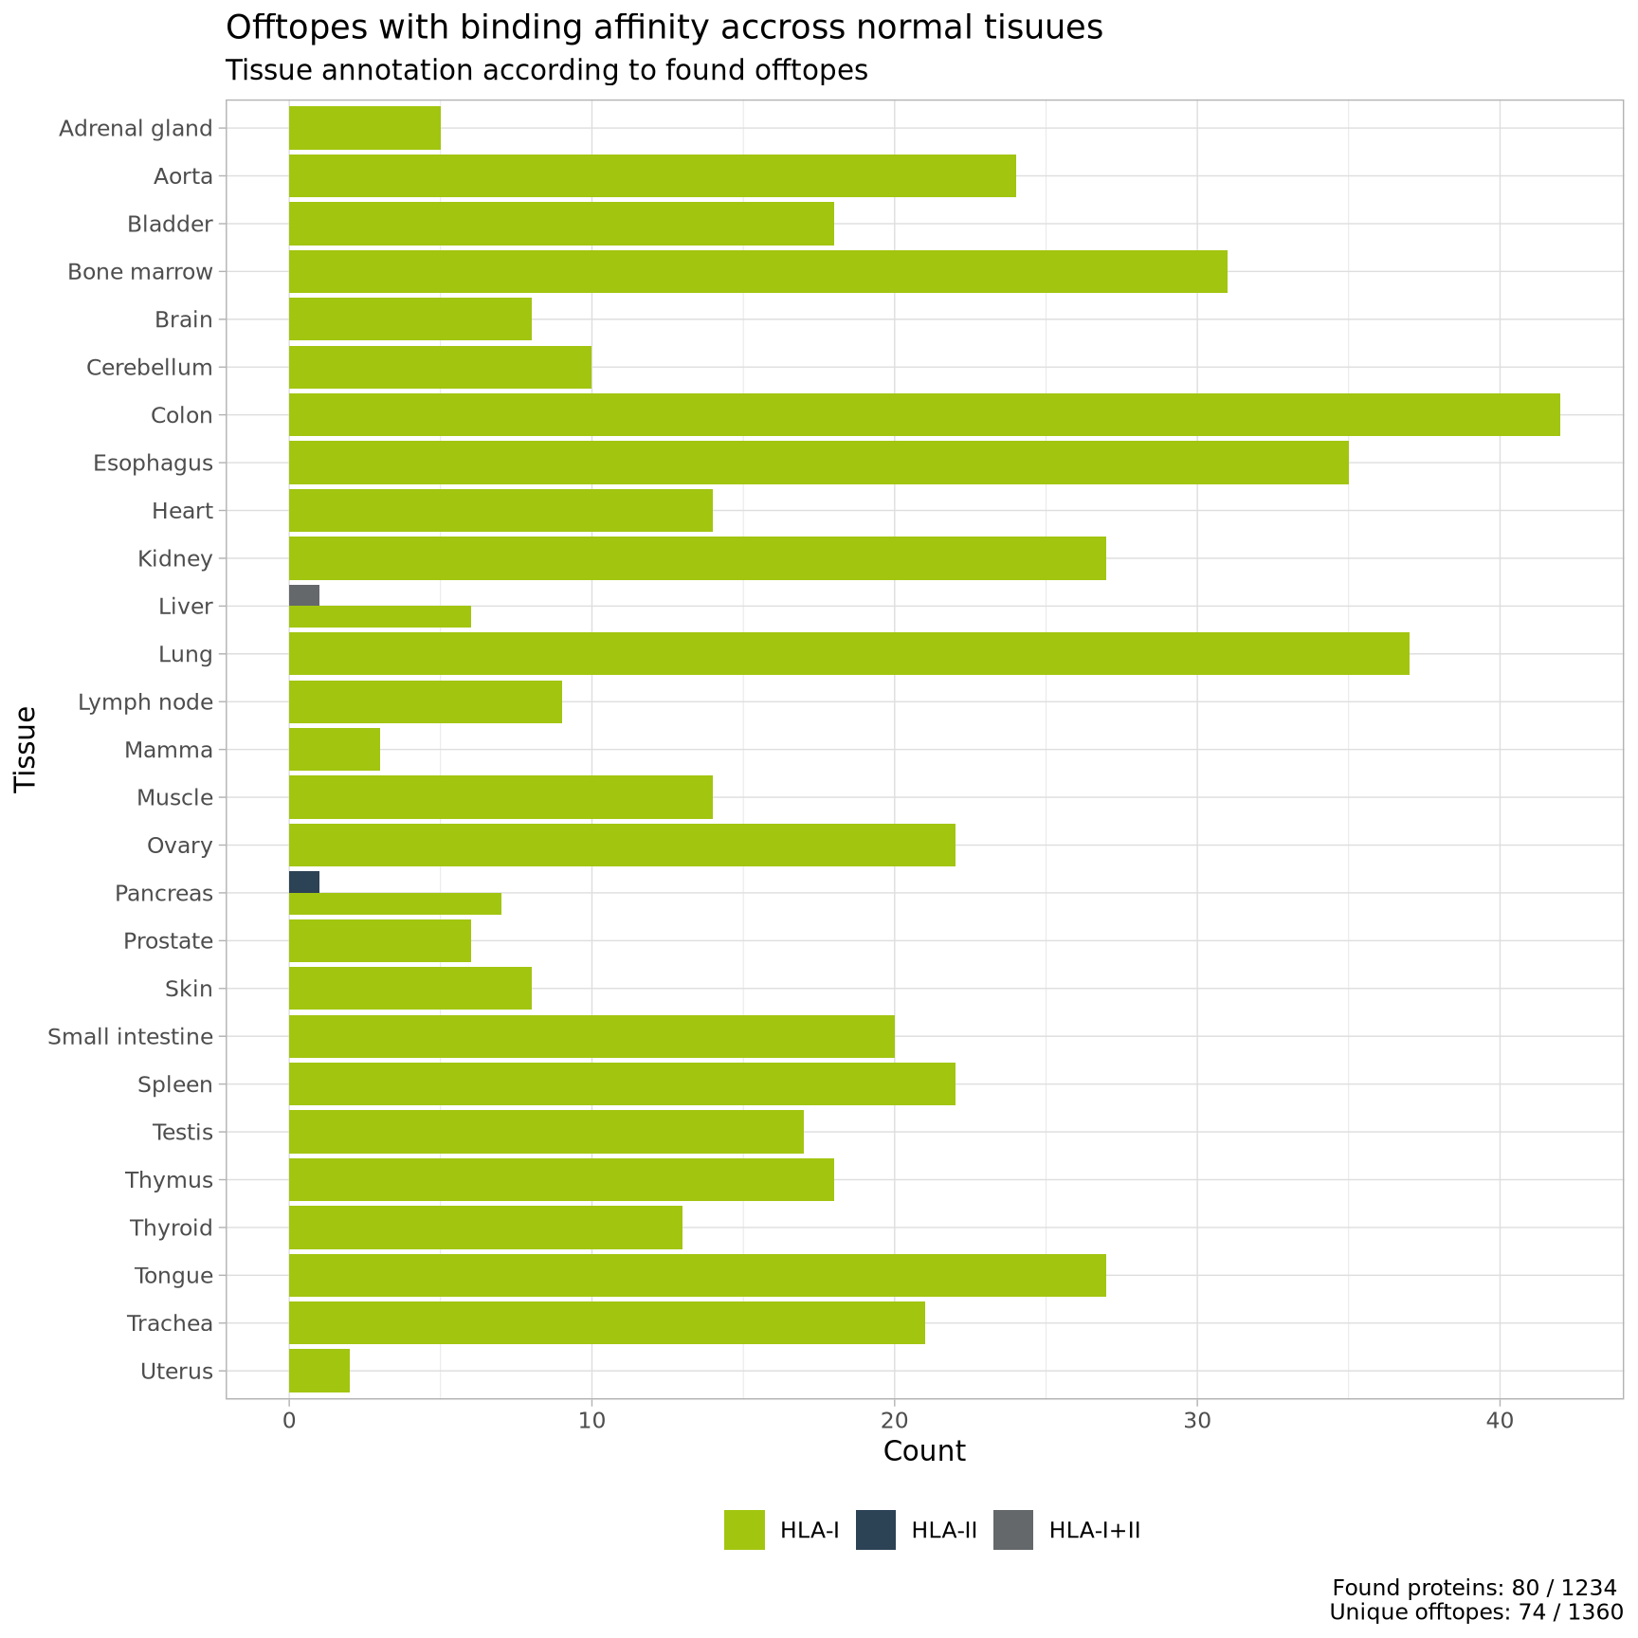
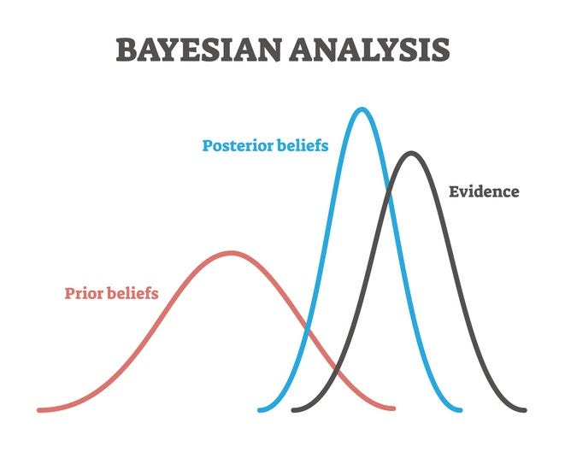
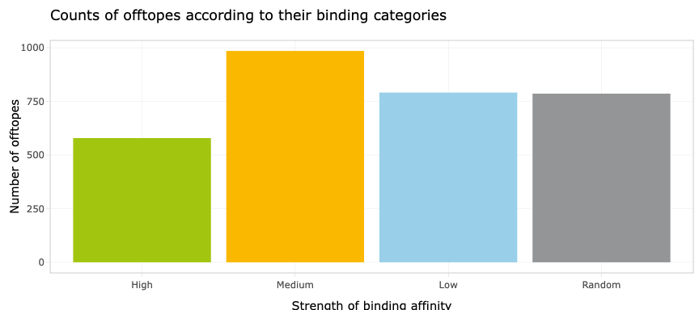
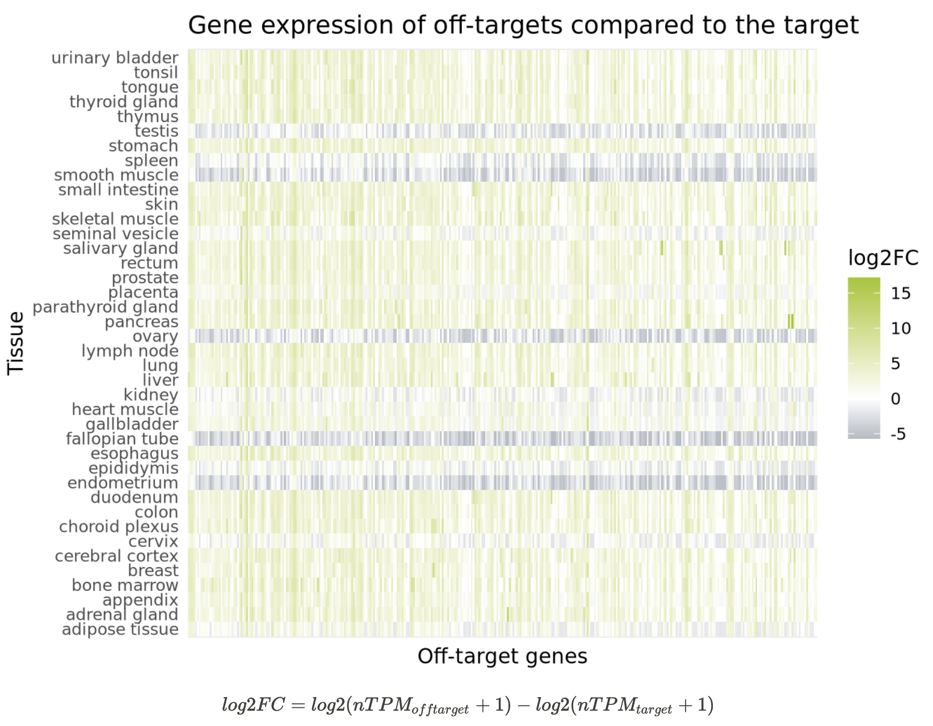

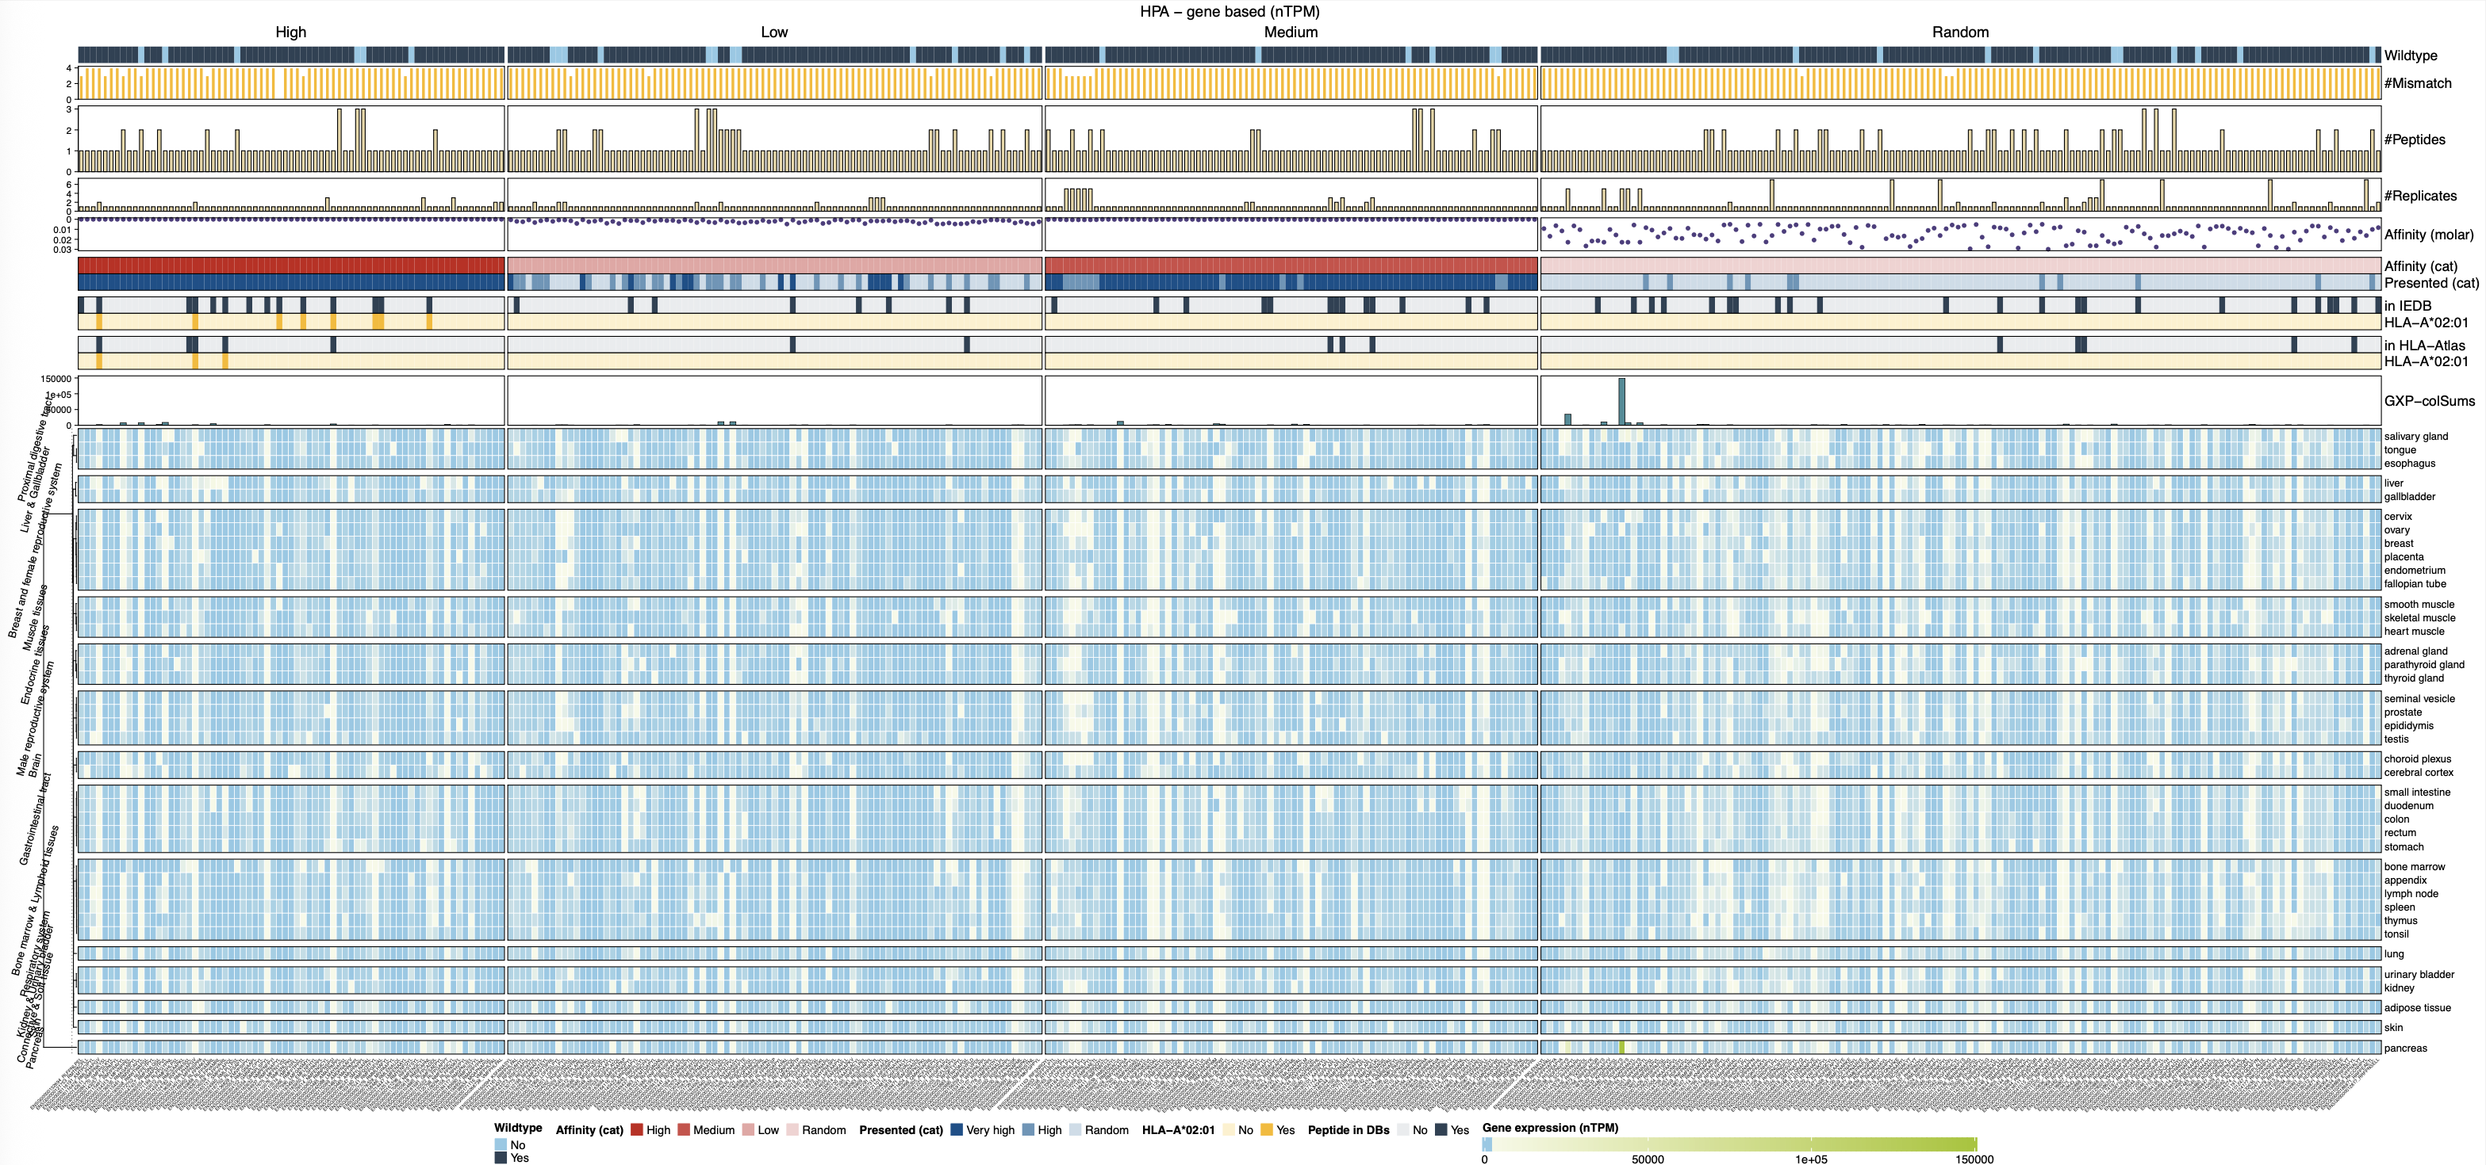

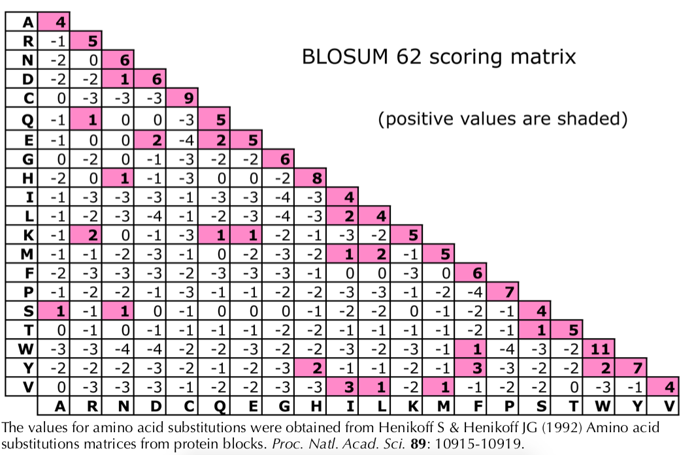
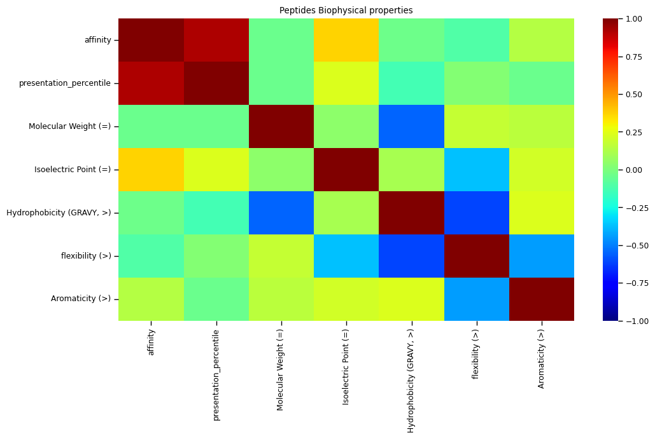
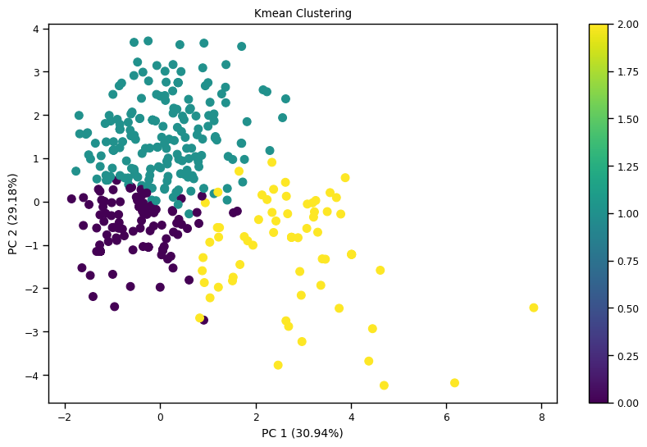
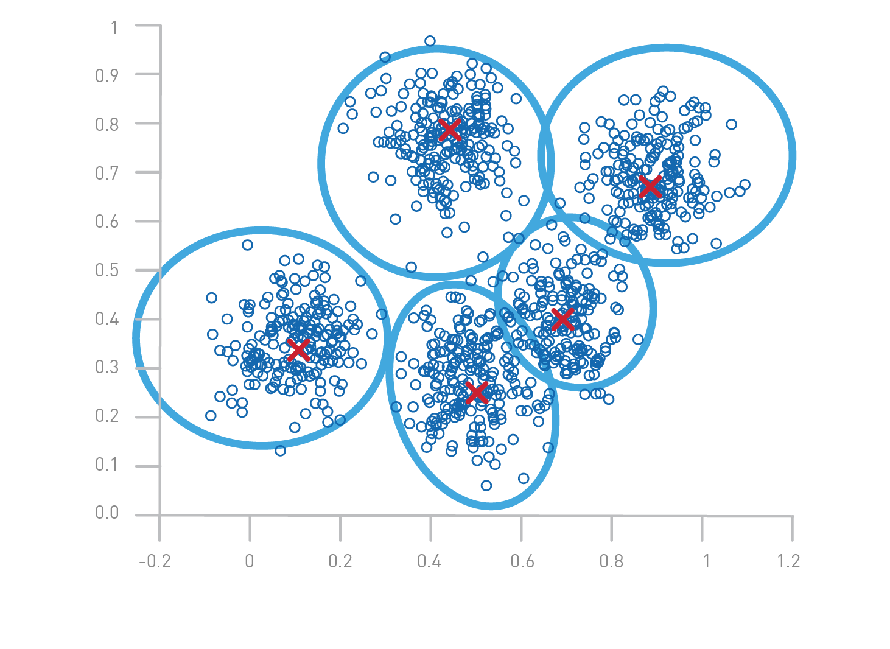
Data acquisition
Target sequence
HLA allele
Patents
Unique MHC knowledge
a
b
c
FindTopes
MutaTopes
PrediTopes
d
e
higher
XScan
AnnoTopes
lower
Targeted features
g
Affinity
BLOSUM62
Features selection
Only relevant or predictive features were considered
High
0 - 50_{nM}
Dimension reduction
PCA/t-SNE/UMAP
Clustering & ranking
K-mean/HDBSCAN
Med
50 - 500_{nM}
Low
500 - 5k_{nM}
Maintaining biological meaning
Indirect biochemical
properties
Bi-Feature formula-based Ranking
Multivariable embedding-based Ranking

Slide 3
FindTopes
ViralTopes
XScan
Target sequence
HLA allele
Patents
FindTopes
MutaTopes
ViralTopes
AnnoTopes
MutaTopes
PrediTopes
XScan
PrediTopes
AnnoTopes
Affinity
BLOSUM62
Features selection
Only relevant or predictive features were considered
High
0 - 50_{nM}
Dimension reduction
PCA/t-SNE/UMAP
higher
Med
50 - 500_{nM}
Low
500 - 5k_{nM}
Clustering & ranking
K-mean/HDBSCAN
lower
Indirect biochemical
properties
Maintaining biological meaning
Bi-Feature formula-based Ranking
Multivariable embedding-based Ranking

Slide 4
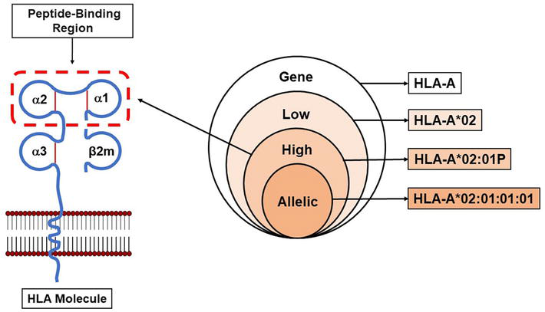
Xscan illustration
Permissive
Flexible
% better than WT
Classical anchor
Neutral
Mean fold change

Slide 5
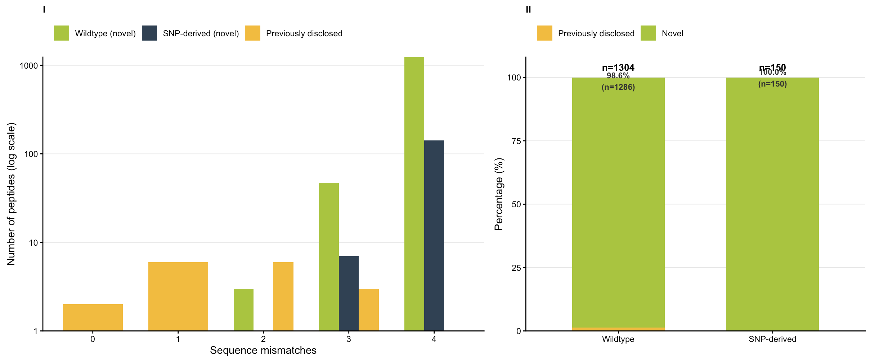
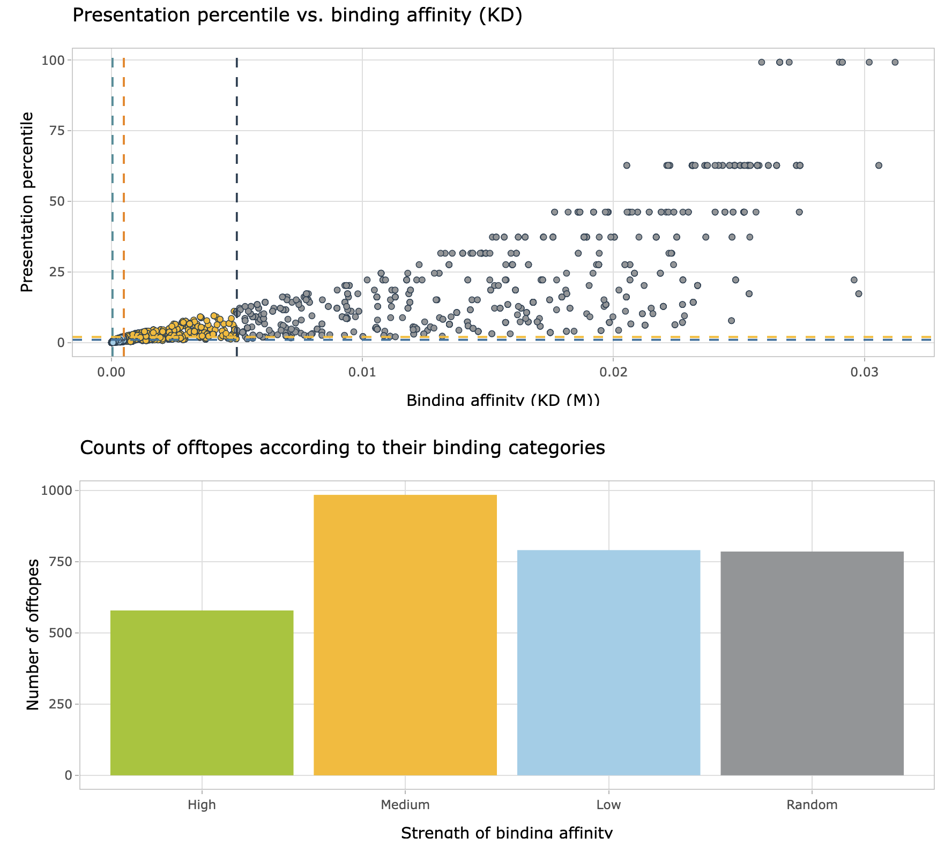
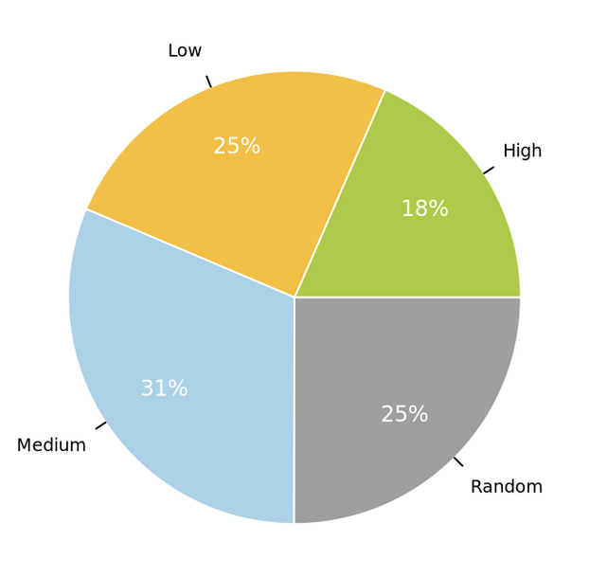
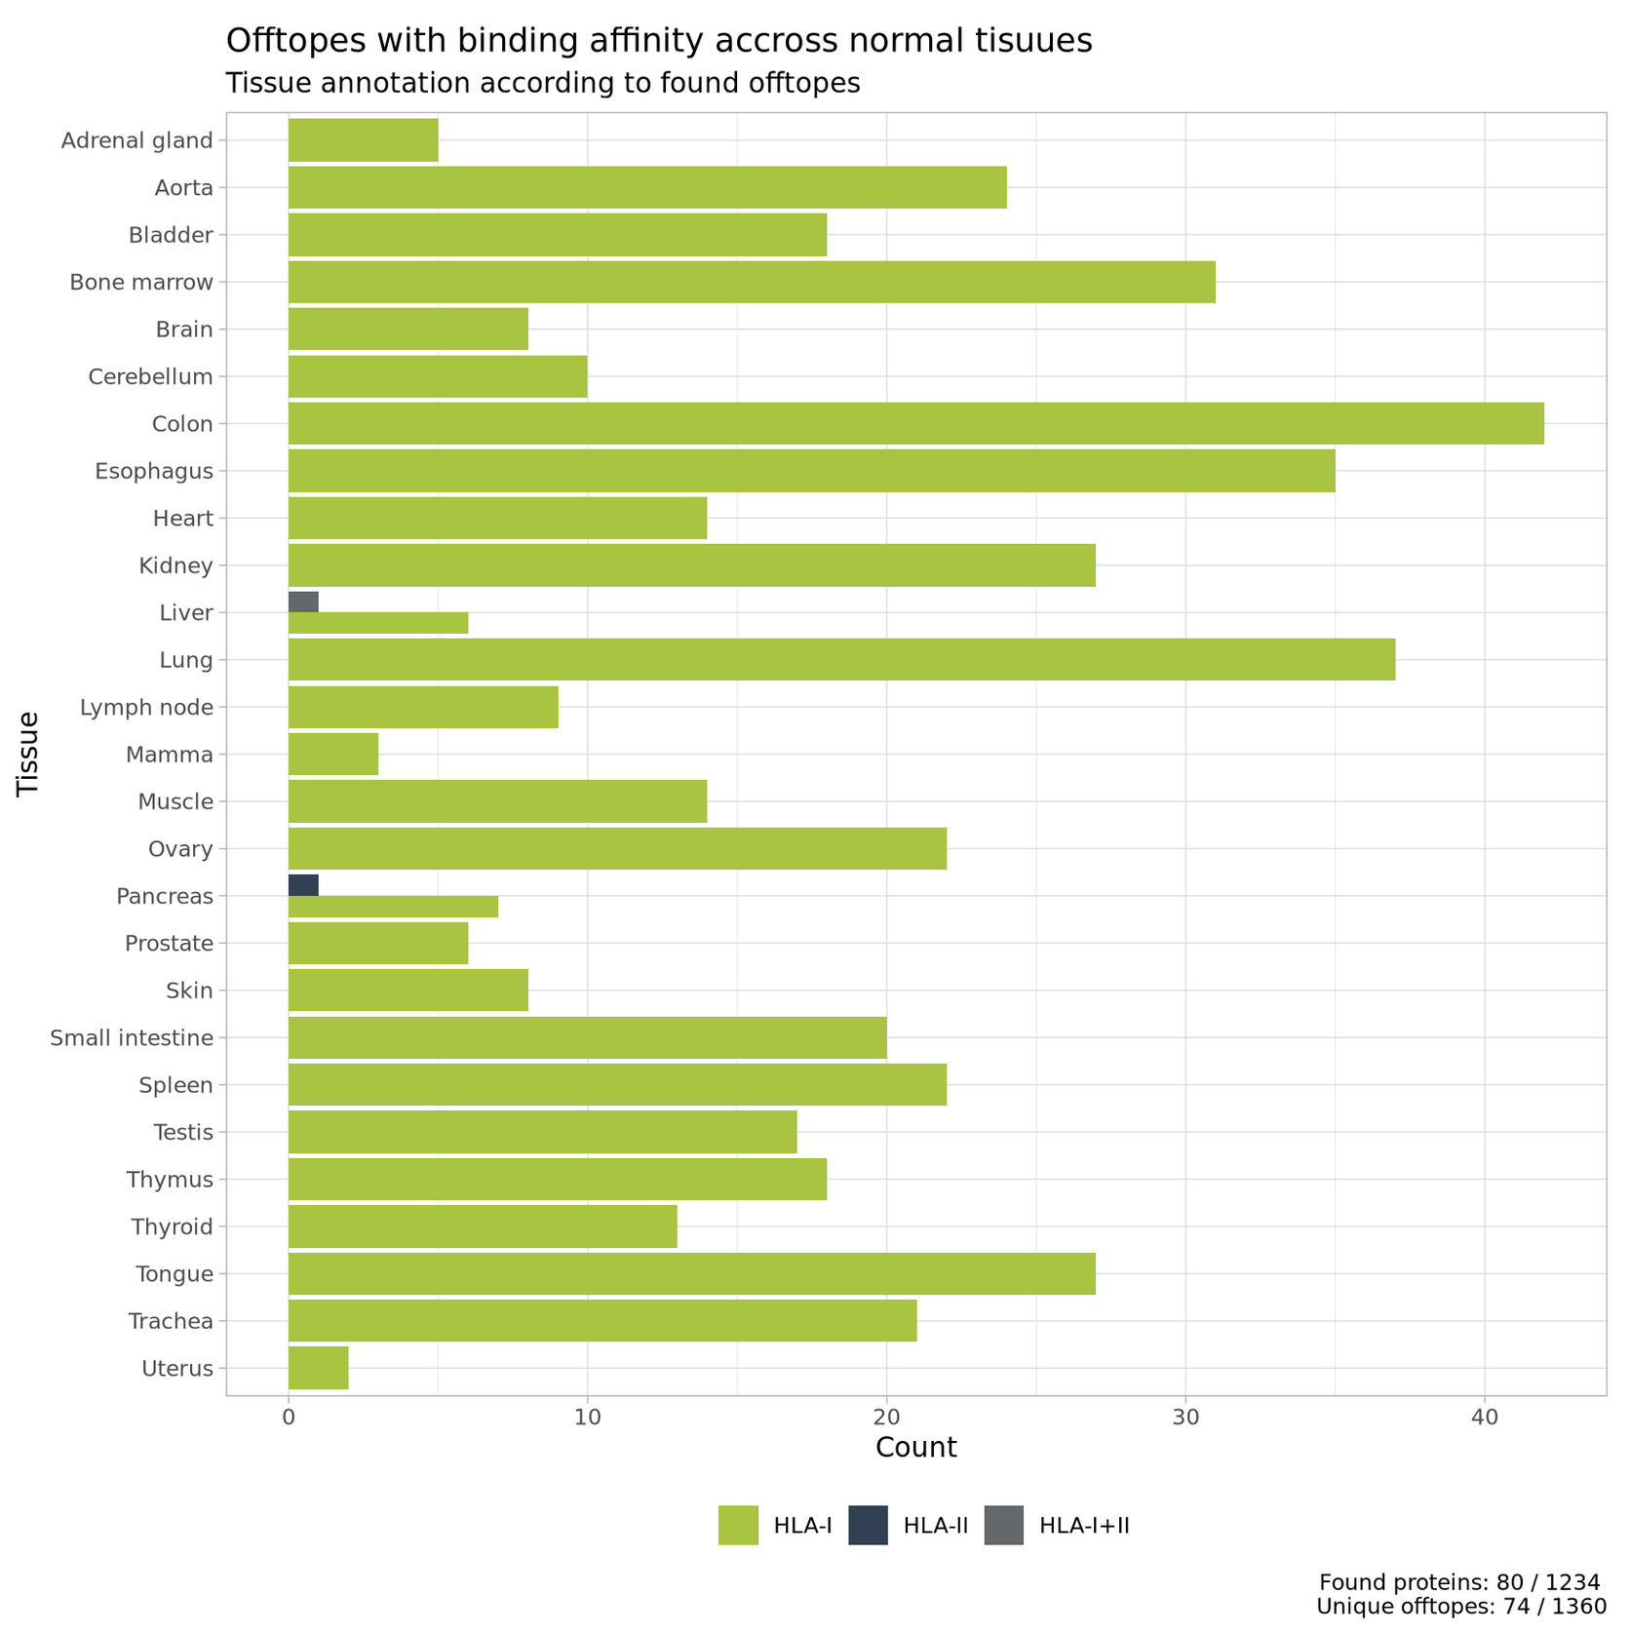
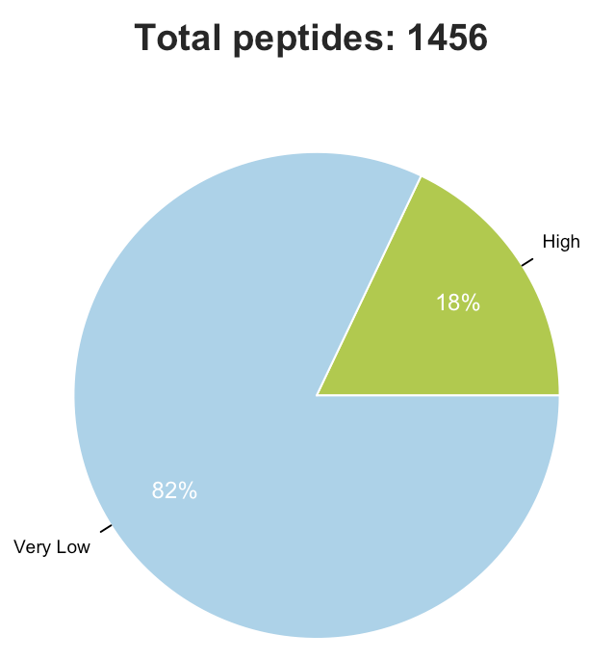
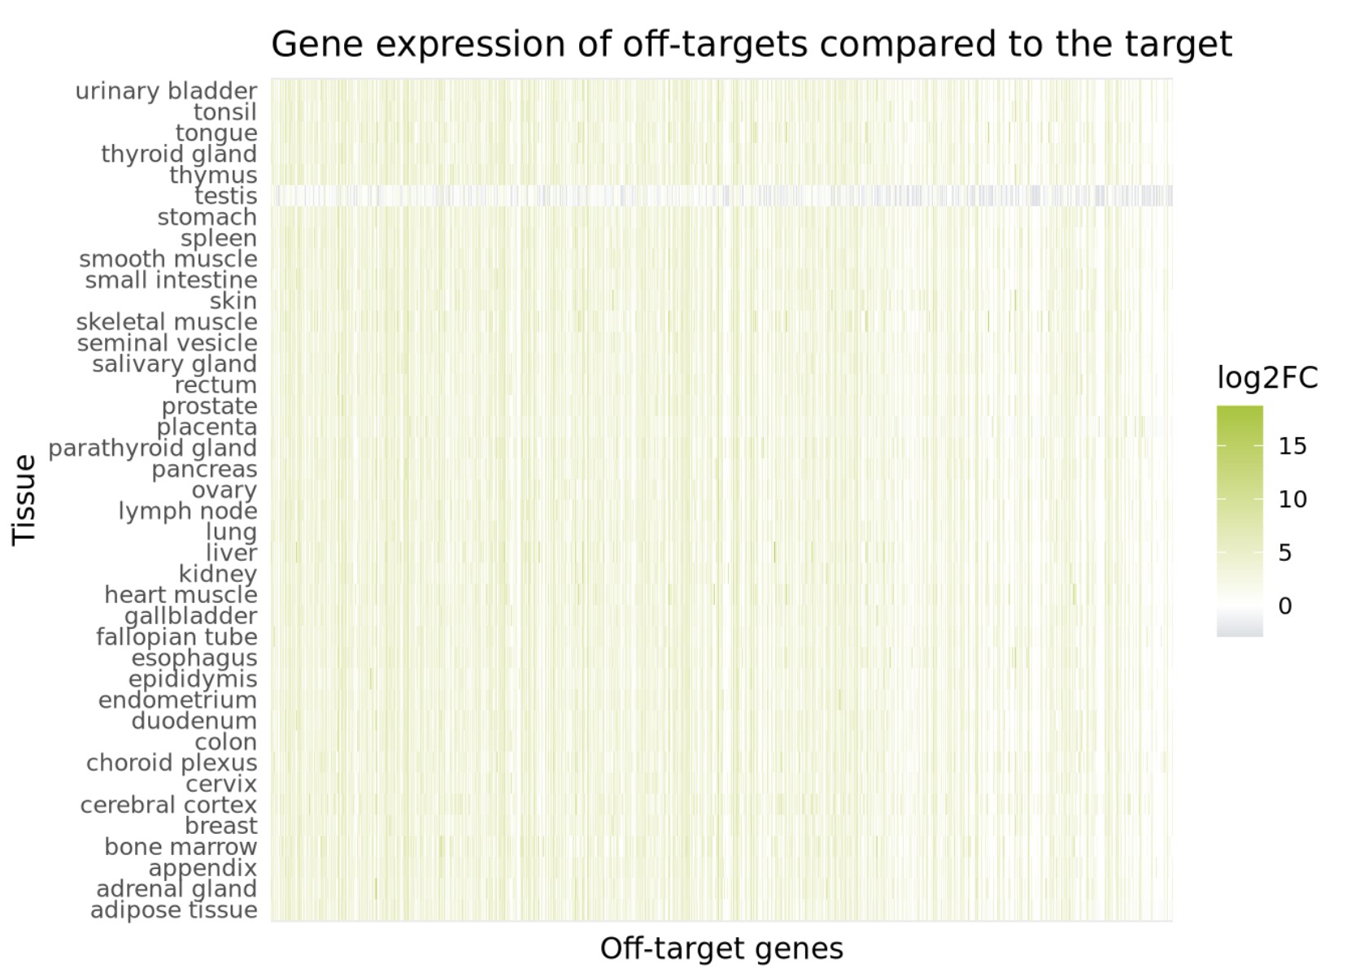
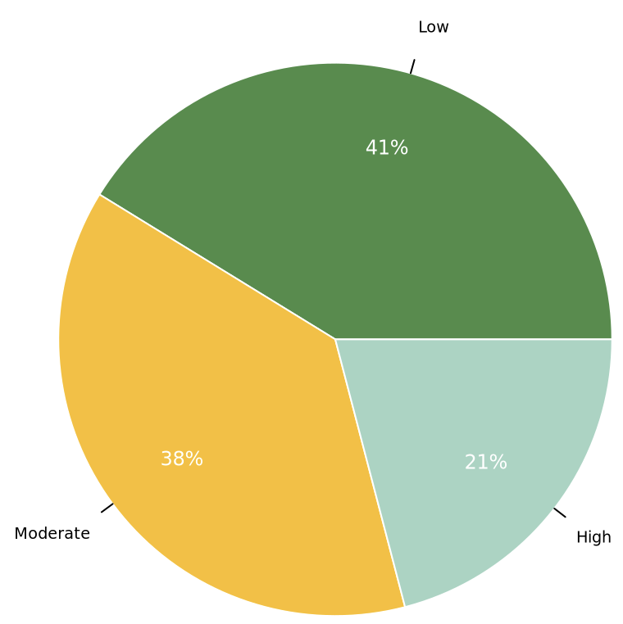
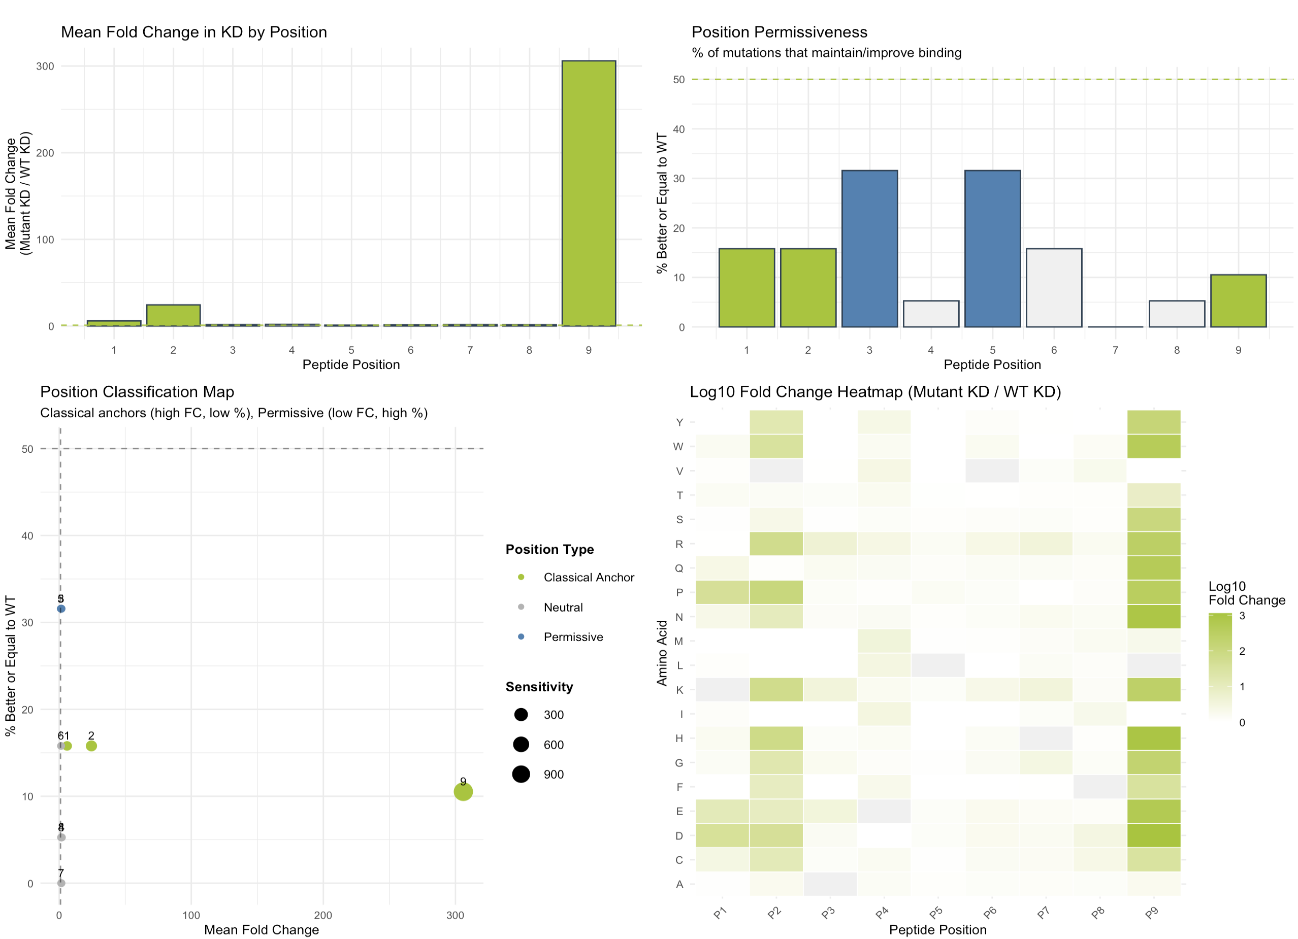
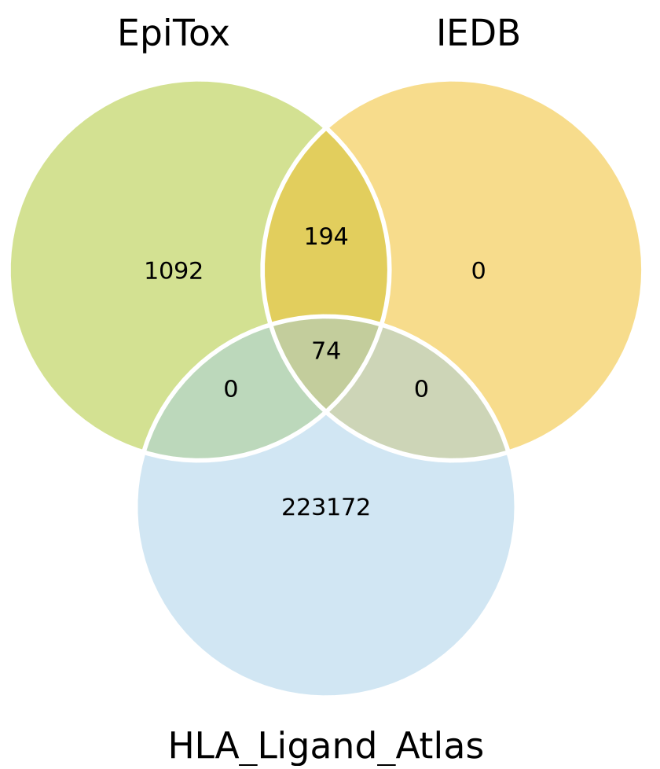
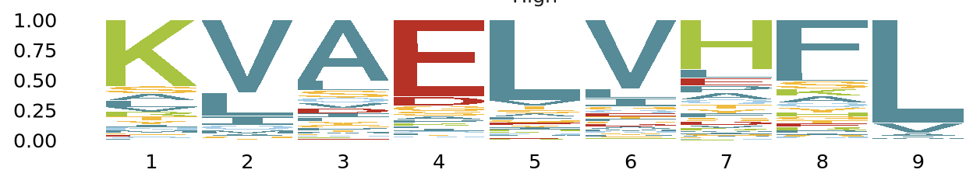
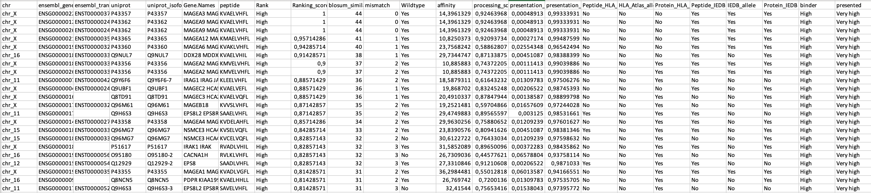
Figure 1
a
b
c
d
e

Slide 6
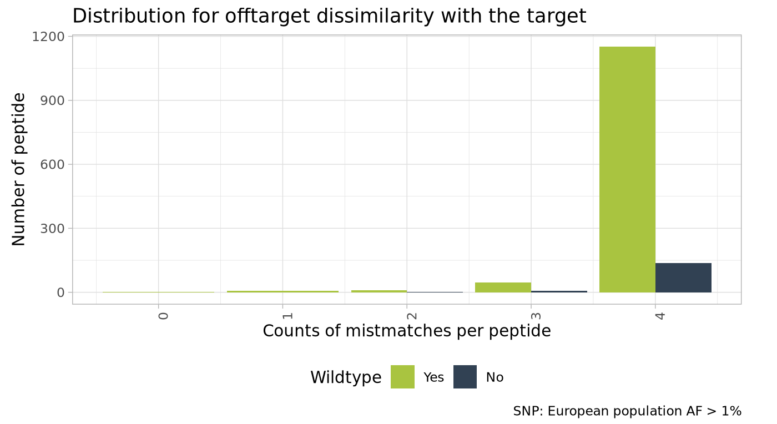
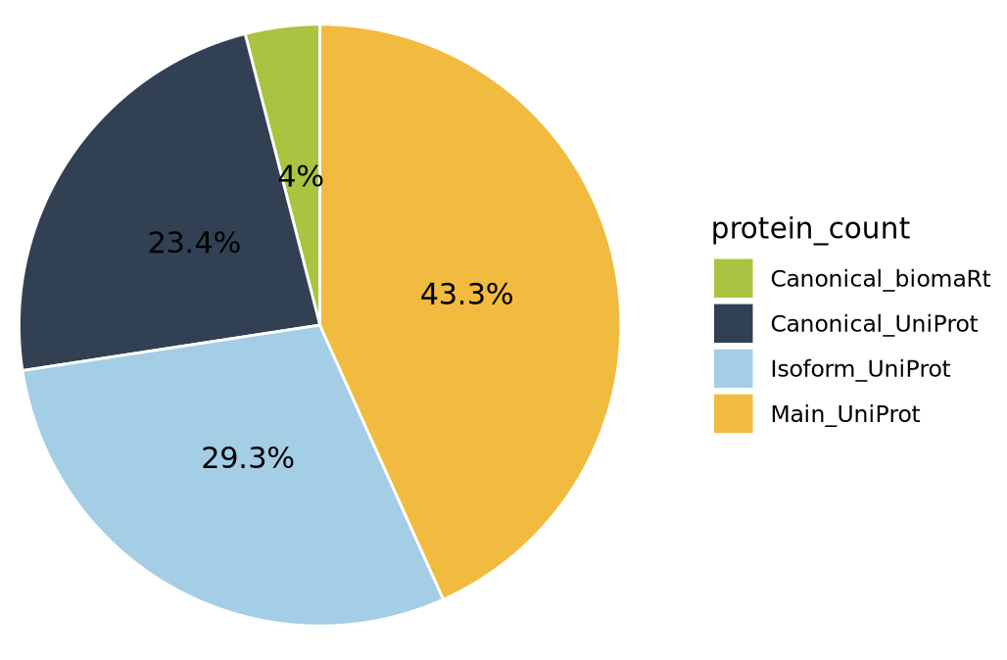
Figure 1
a
b
c
d

Slide 7
Figure1: SNPs integration
Off-targets
WT only
Off-targets genomic location
Extract SNPs
QC: PASS
AF
Population ID
Mutate off-targets
Edit distance < threshold
Off-targets
WT + MUT
Annotate SNPs
SNPs Exom file
SNPs annotation
Peptide | Found SNPs | Mutated sequence | Notion
KVAELVHFL | - | - | WT
 | SNP₁:A₂ | KAAELVHFL | MUT
 | SNP₂:A₈ | KVAELVHAL | MUT
 | SNP₁:A₁ | AVAELVHFL | MUT

Slide 8
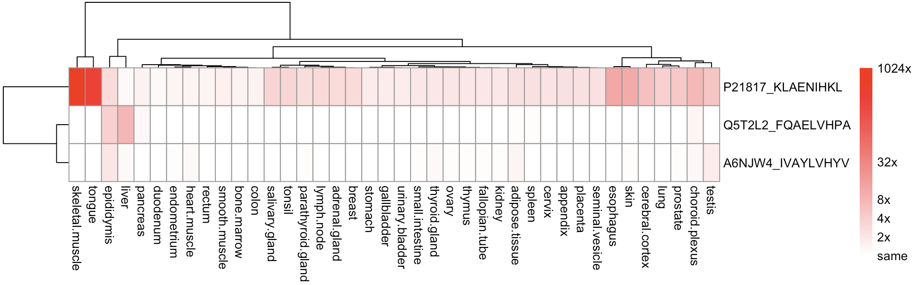
Figure1: SNPs integration
Peptide | Lab guru | KD | n | mismatch | Binder | Log2_FC | Pass | B | Rank
FQAELVHPA | PEP1842 | 3.463011e-07 | 24 | 4 | Binder | -0.9383164 | 3 | 15 | High
IVAYLVHYV | PEP1678 | 1.644378e-07 | 24 | 4 | Binder | 0.1361684 | 3 | 23 | High
KLAENIHKL | PEP1661 | 2.933844e-08 | 24 | 4 | Binder | 2.6228463 | 3 | 24 | High
Off-targets
WT only
Off-targets genomic location
Extract SNPs
QC: PASS
AF
Population ID
Mutate off-targets
Edit distance < threshold
Off-targets
WT + MUT
Annotate SNPs
SNPs Exom file
SNPs annotation

Slide 9
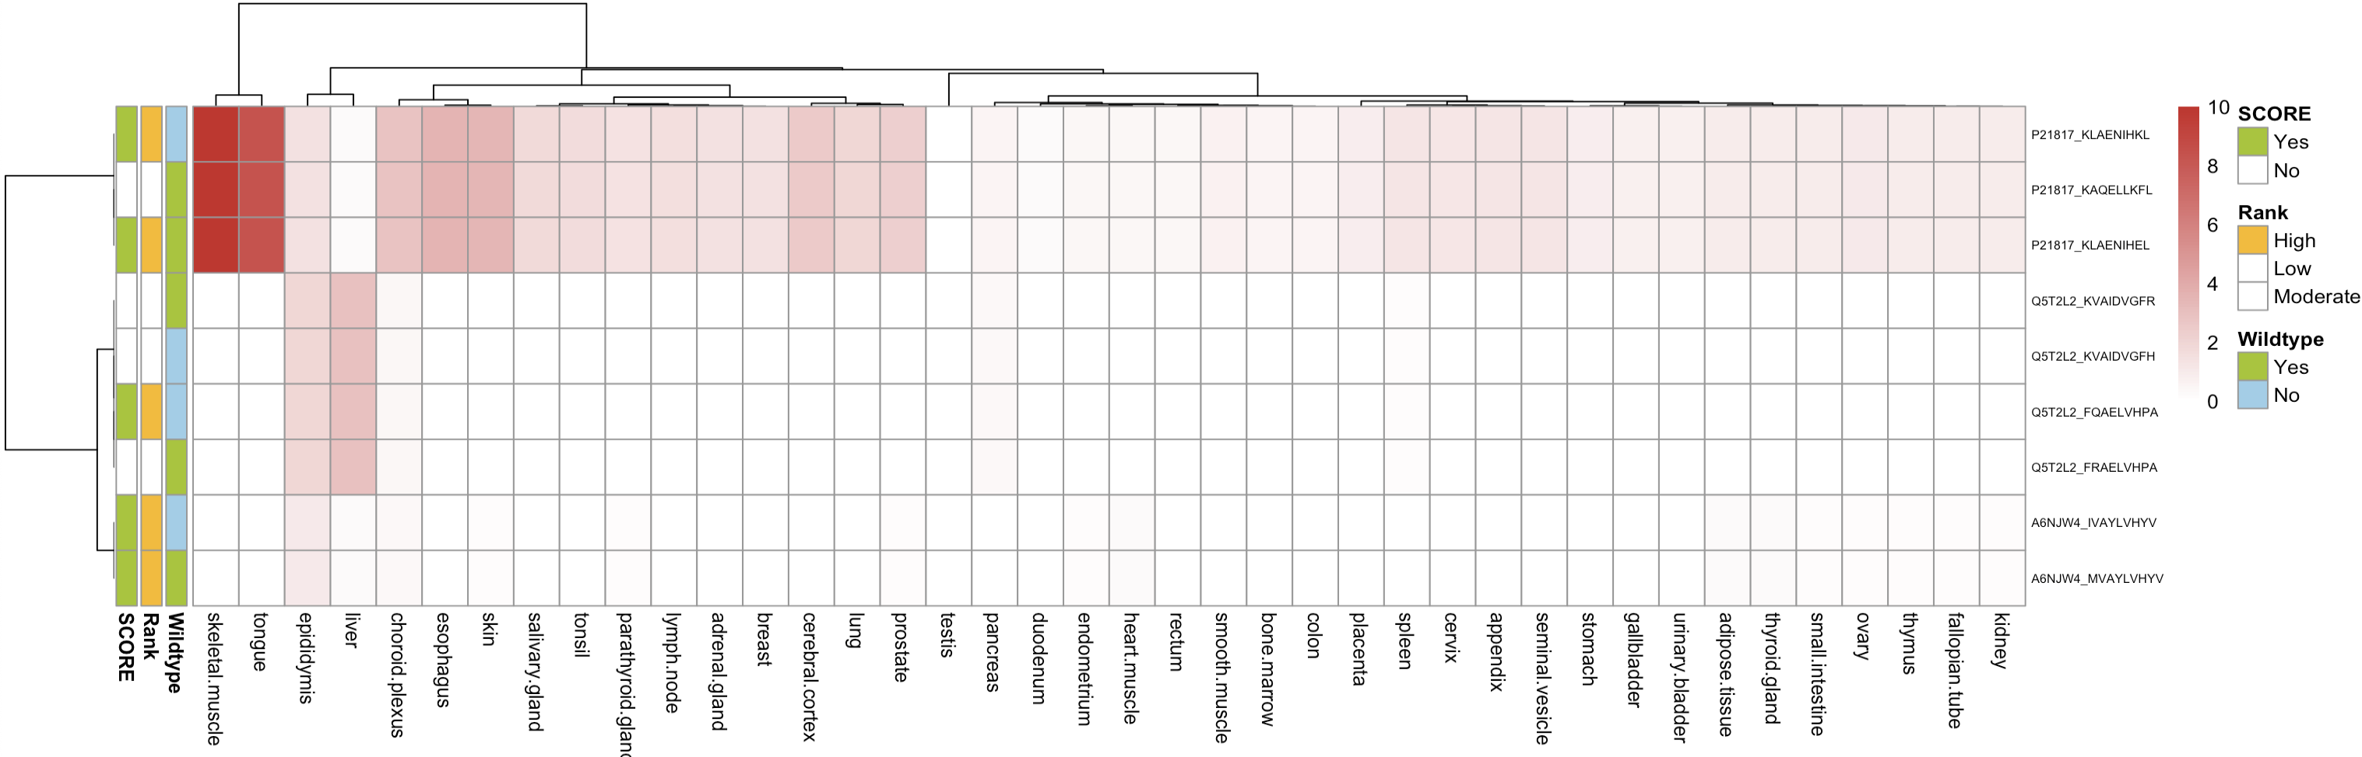
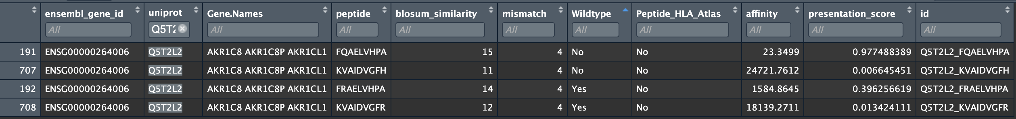
Figure1: SNPs integration
a
b
Peptide | Lab guru | KD | n | mismatch | Binder | Log2_FC | Pass | B | Rank
FQAELVHPA | PEP1842 | 3.463011e-07 | 24 | 4 | Binder | -0.9383164 | 3 | 15 | High
IVAYLVHYV | PEP1678 | 1.644378e-07 | 24 | 4 | Binder | 0.1361684 | 3 | 23 | High
KLAENIHKL | PEP1661 | 2.933844e-08 | 24 | 4 | Binder | 2.6228463 | 3 | 24 | High

Slide 10
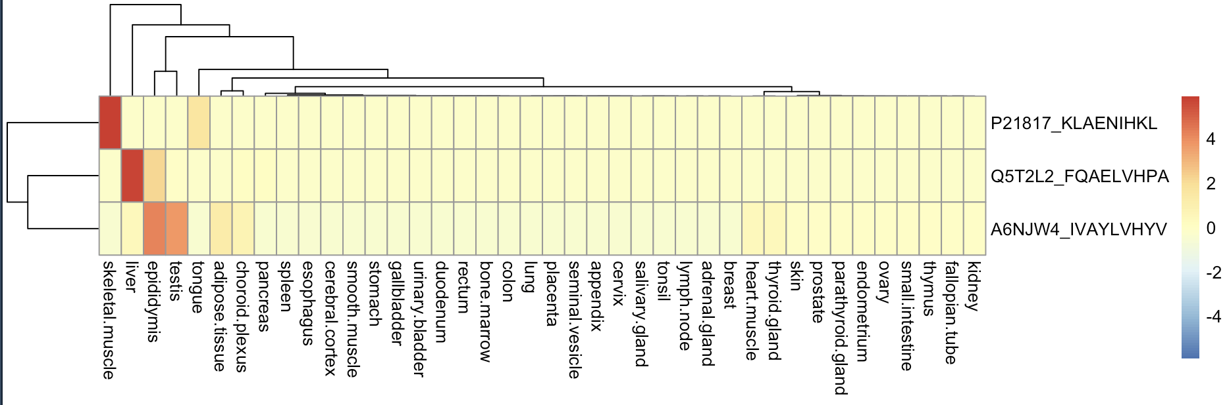
SNPs in peptides with high risk
Peptide | Lab guru | KD | n | mismatch | Binder | Log2_FC | Pass | B | Rank
FQAELVHPA | PEP1842 | 3.463011e-07 | 24 | 4 | Binder | -0.9383164 | 3 | 15 | High
IVAYLVHYV | PEP1678 | 1.644378e-07 | 24 | 4 | Binder | 0.1361684 | 3 | 23 | High
KLAENIHKL | PEP1661 | 2.933844e-08 | 24 | 4 | Binder | 2.6228463 | 3 | 24 | High

Slide 11
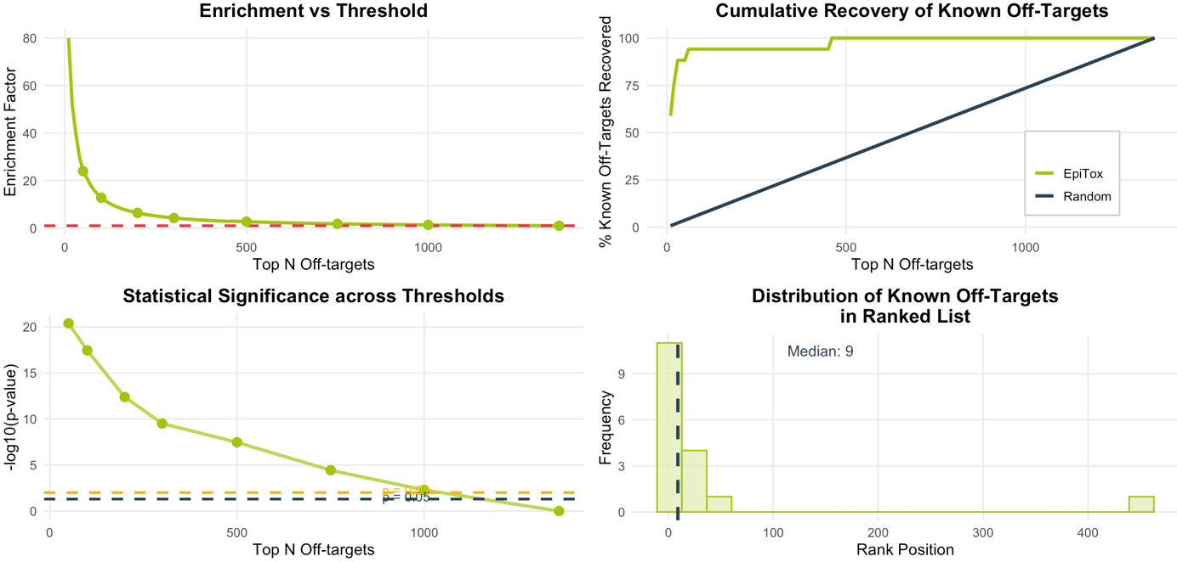
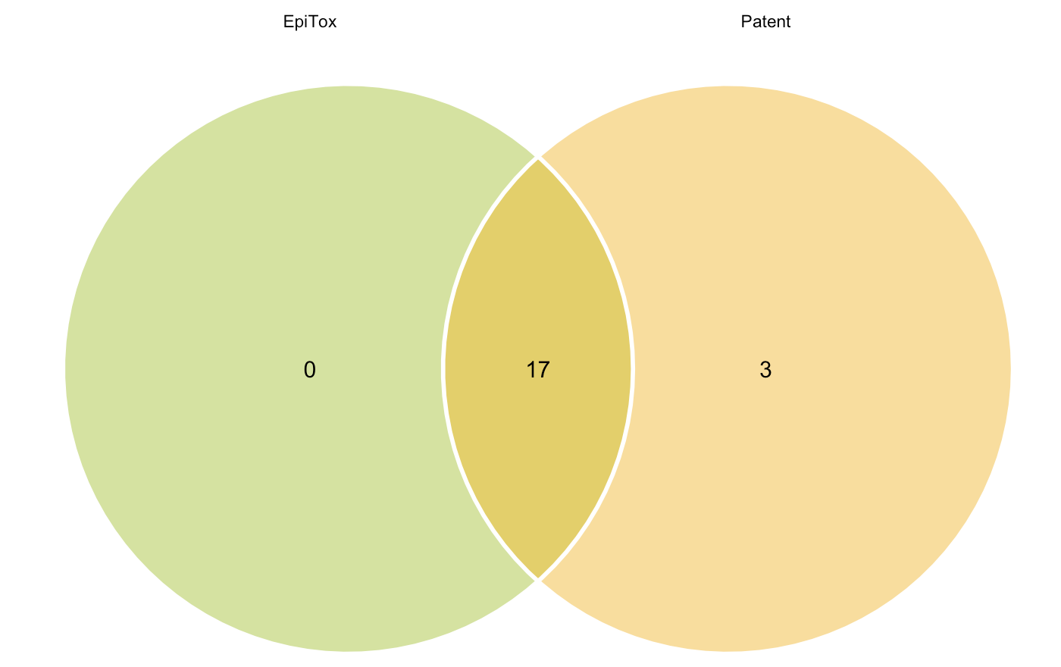

Slide 12
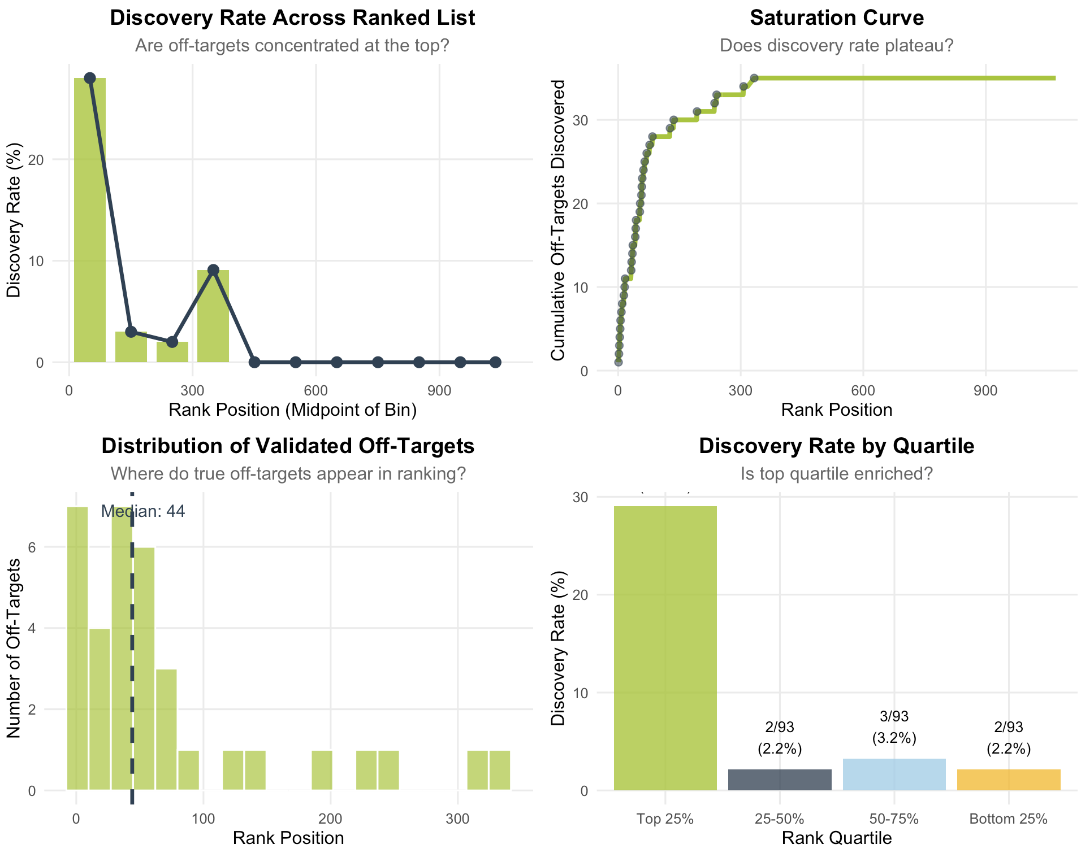
Score results with reference AB

Slide 13
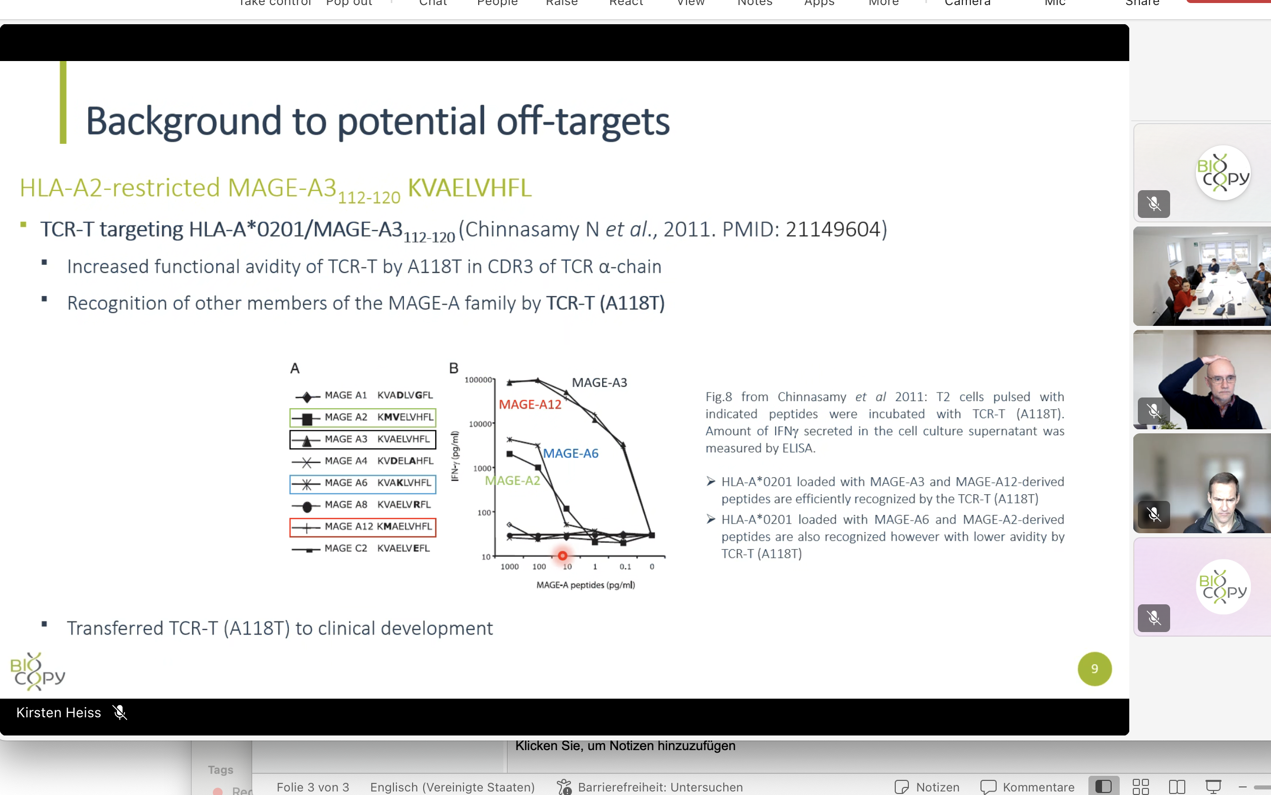
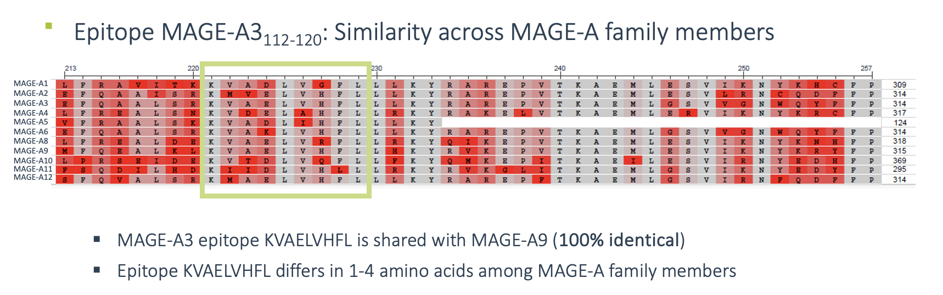

Slide 14
Score Interpretation Framework:
High similarity (35-44): Very strong matches, likely functionally similar regions
Moderate similarity (20-34): Good matches, worth investigating further
Weak similarity (10-19): Marginal matches, may be meaningful in context
Low similarity (1-9): Poor matches, likely not biologically significant
No similarity (≤0): Random or worse alignment quality
For initial filtering: Score ≥ 20 (roughly 45% of your max score) For detailed analysis: Score ≥ 15 (about 35% of max) For exploratory work: Score ≥ 10 (about 25% of max)

Slide 15
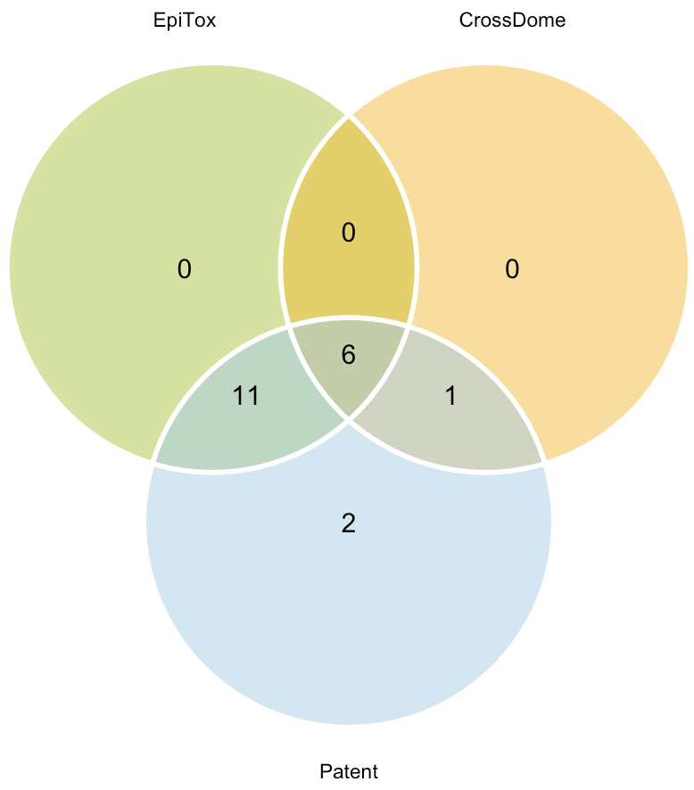
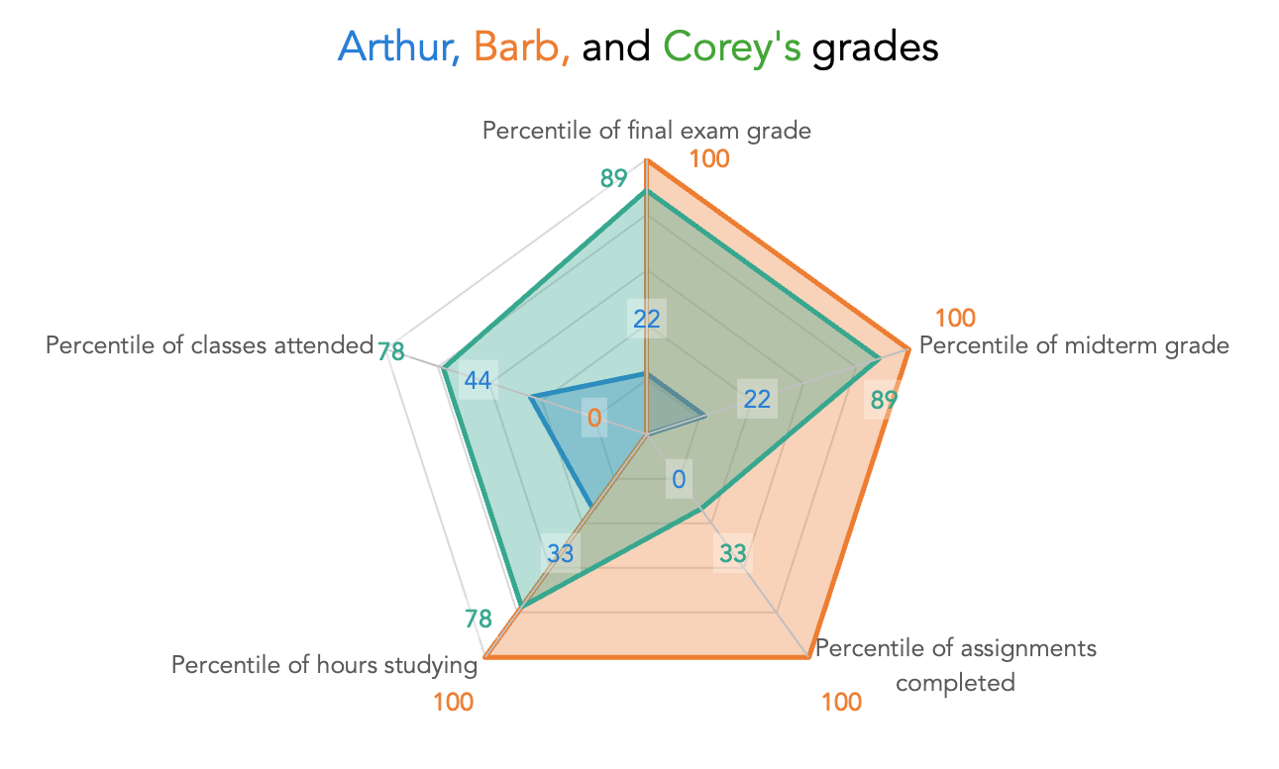
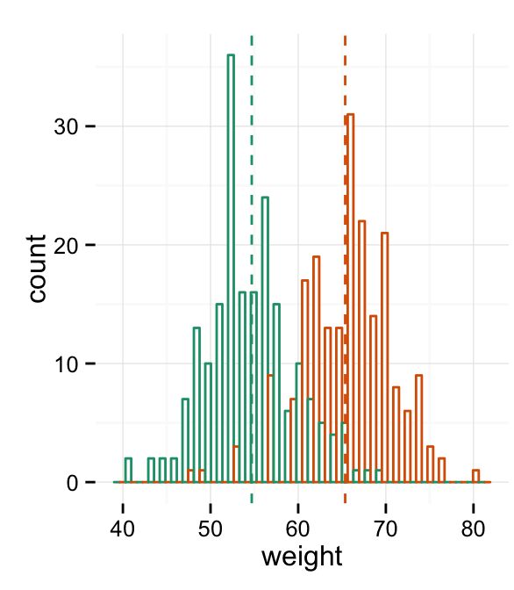
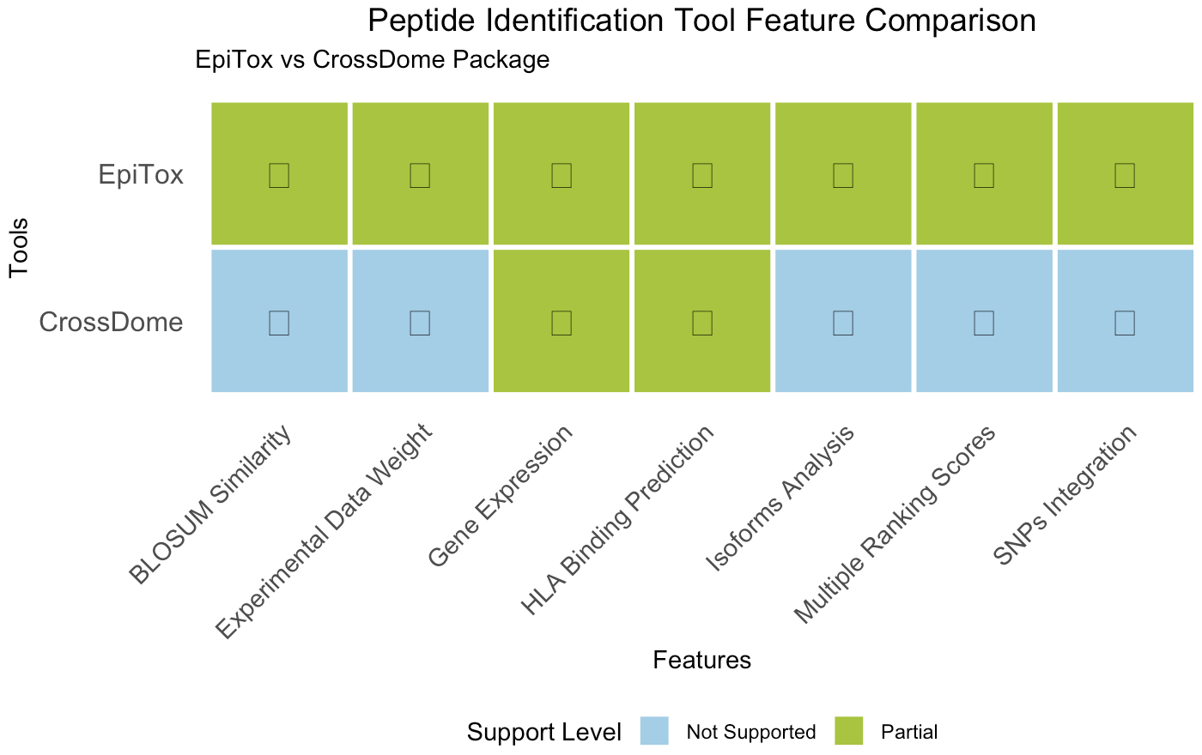
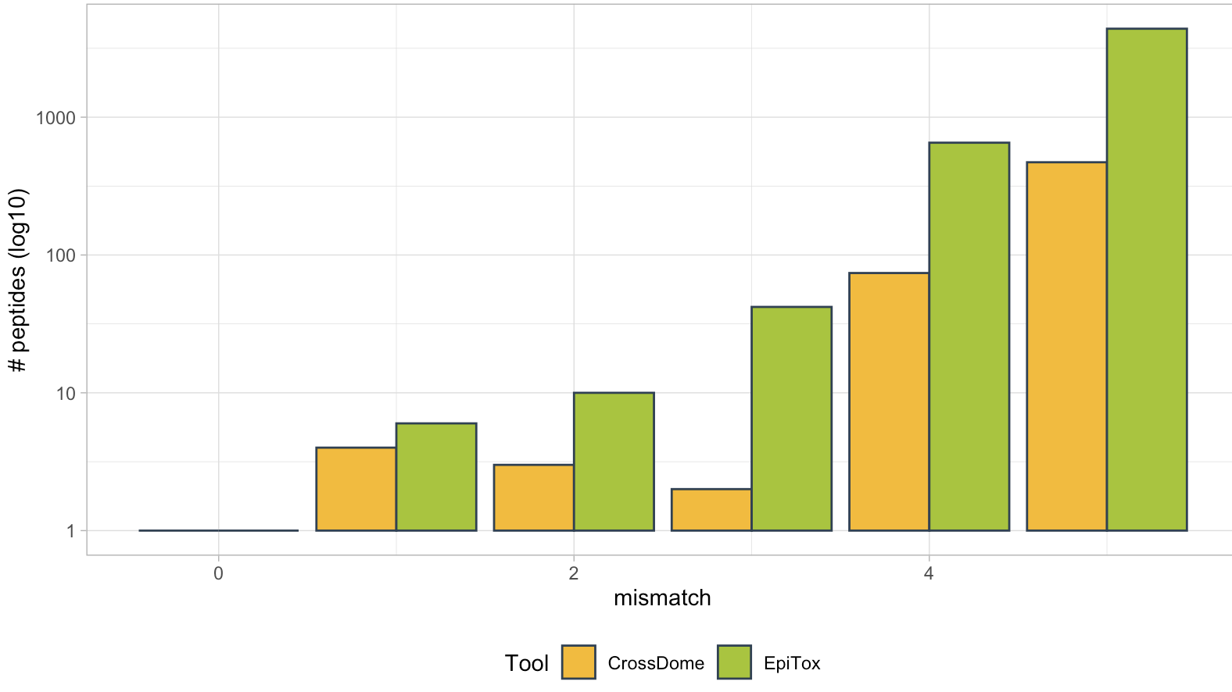
Benchmark & Validation
Radar plot for multiple parameters:
Genetics
Features
Peptide counts
HLA-context
Peptide counts per tools
crossDome
scrap
Similarity scores distribution

Slide 16



Figure 1: EpiTox overall
Target sequence
HLA allele
Peptides list
ViralTopes
1) Off-targets identification mode
2) Peptides annotation mode
FindTopes
MutaTopes
Annotator
Non-Human mode
xscan
PrediTopes
AnnoTopes
DBfetch
Human mode

Slide 17
Figure 2: pepmatch vs. blastp

Slide 18
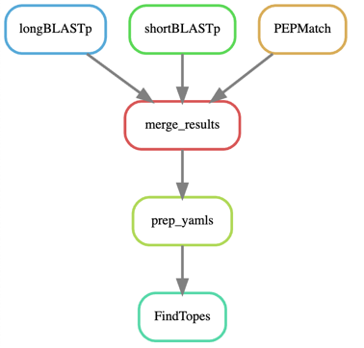
Figure 3: findtopes

Slide 19
Figure 4: mutation logic
Gene
Exon 1
Exon 2
Exon 3
Exon 4
Exon 5
Isoform A
(Exons 1-2-3-4-5)
Protein coordinates
SNP₁
SNP₂
1
100
AA 130 - 160
200
300
Peptide
Isoform B
(Exons 1-3-4-5)
Protein coordinates
SNP₁: AA 155
SNP₂: AA 200
1
100
200
300
AA 70 - 110
Peptide
SNP₁: AA 90
SNP₂: AA 120

Slide 20
Figure 4: mutation logic

Slide 21
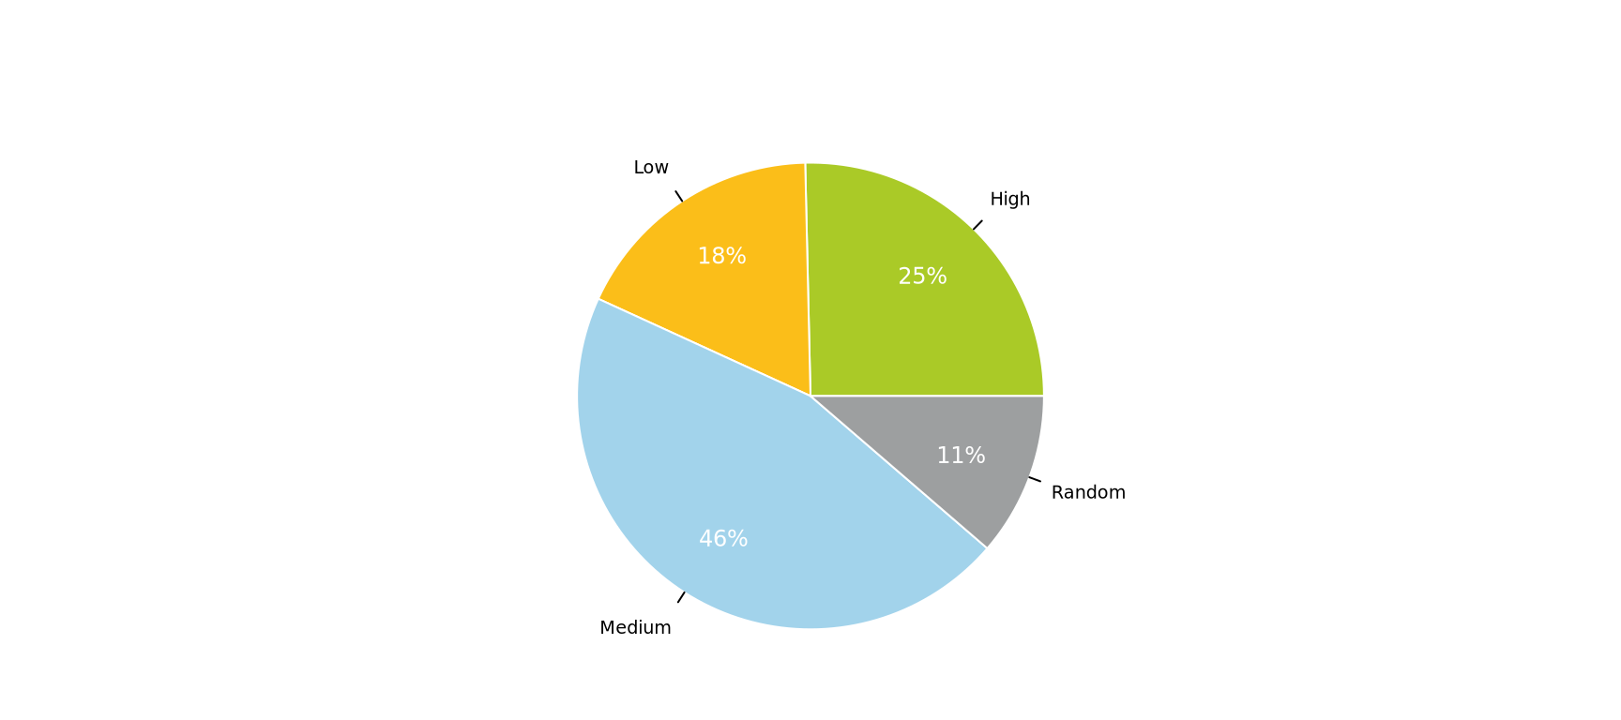
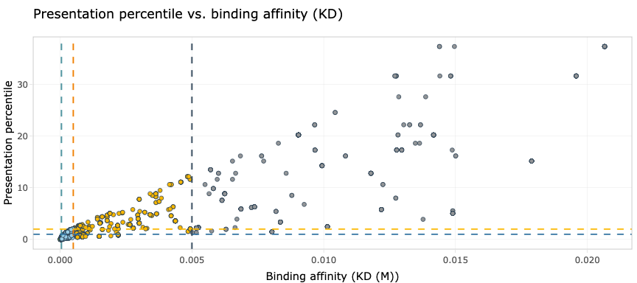
Figure 5: PrediTopes affinity vs. presentation

Slide 22
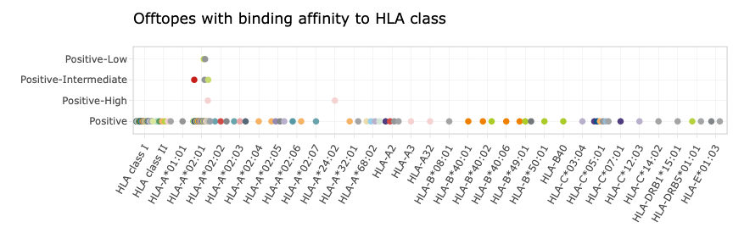
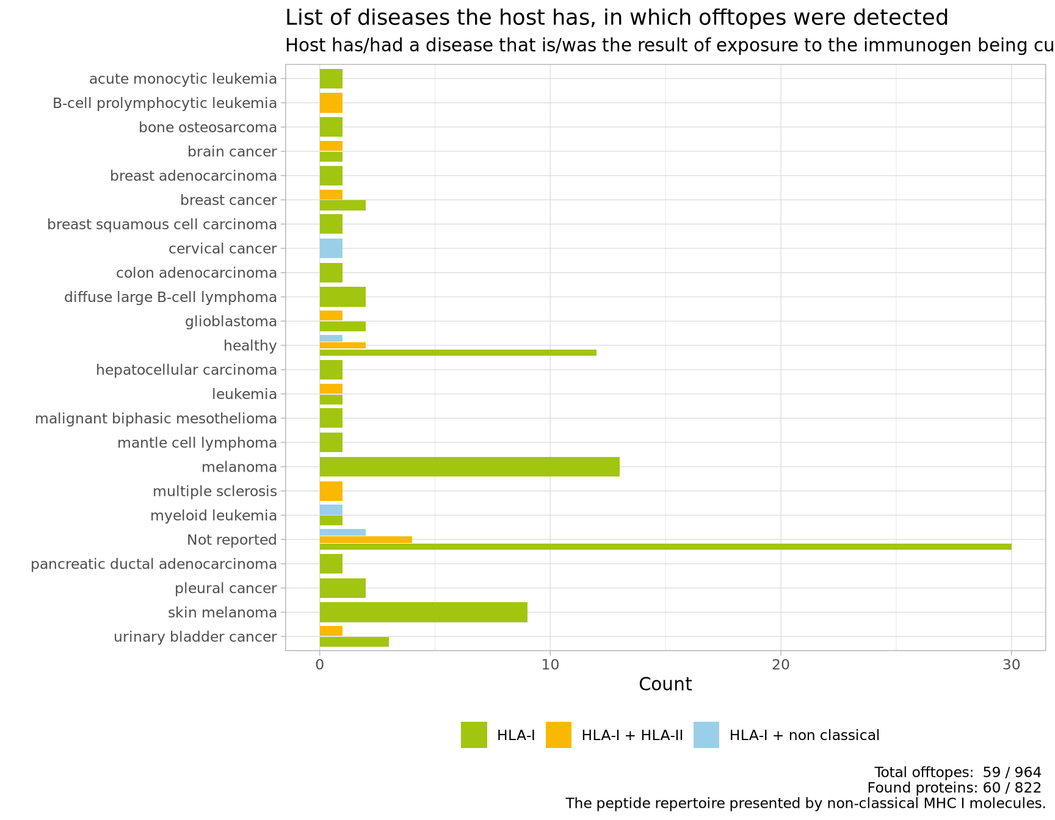
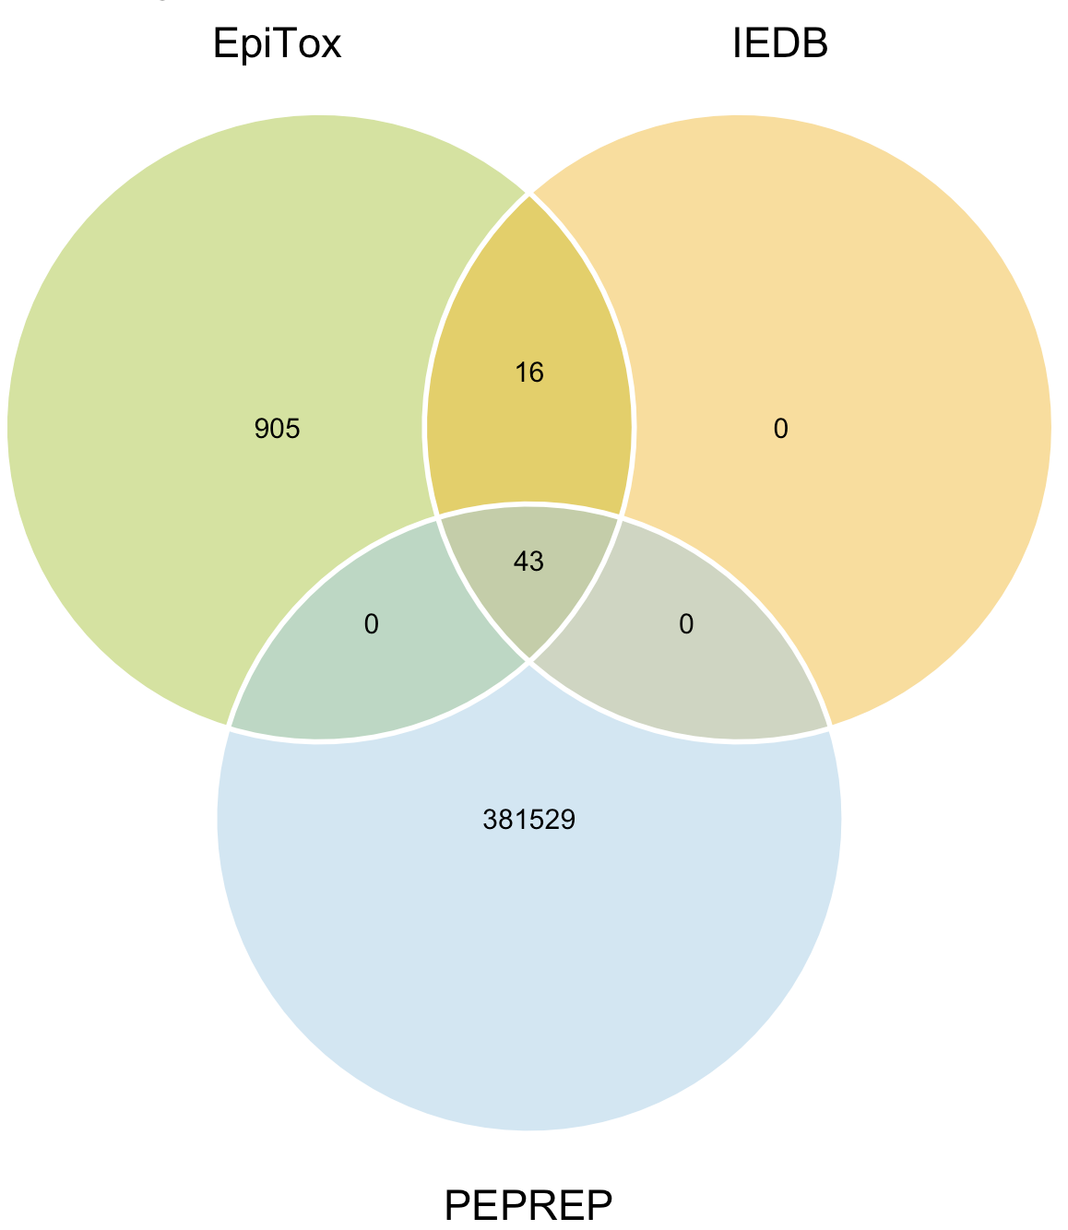
Figure 6: PrediTopes annotation

Slide 23
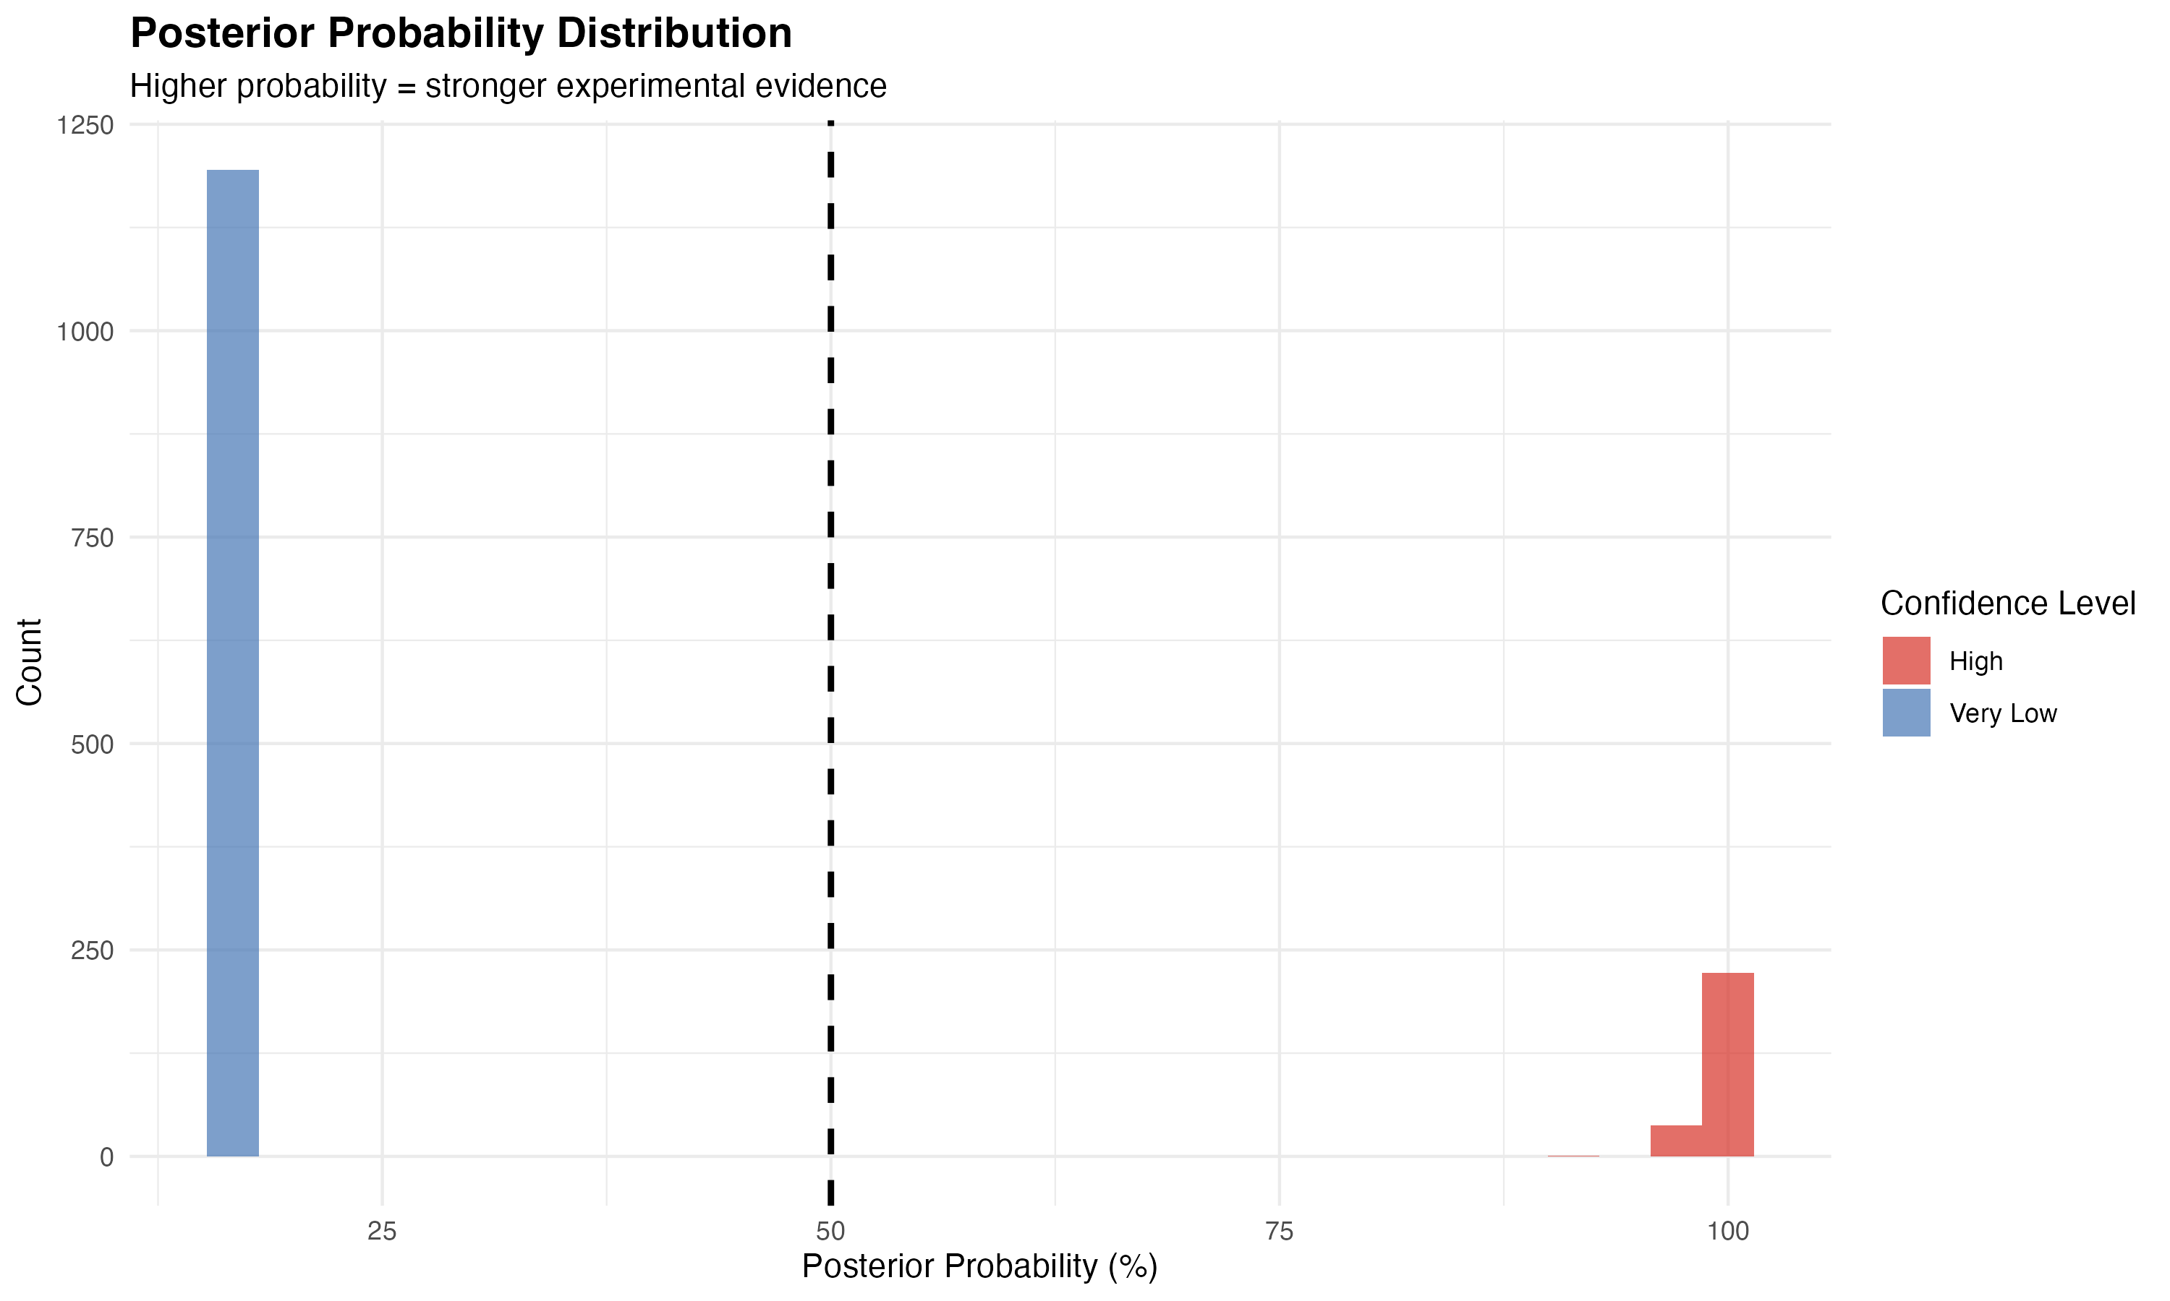
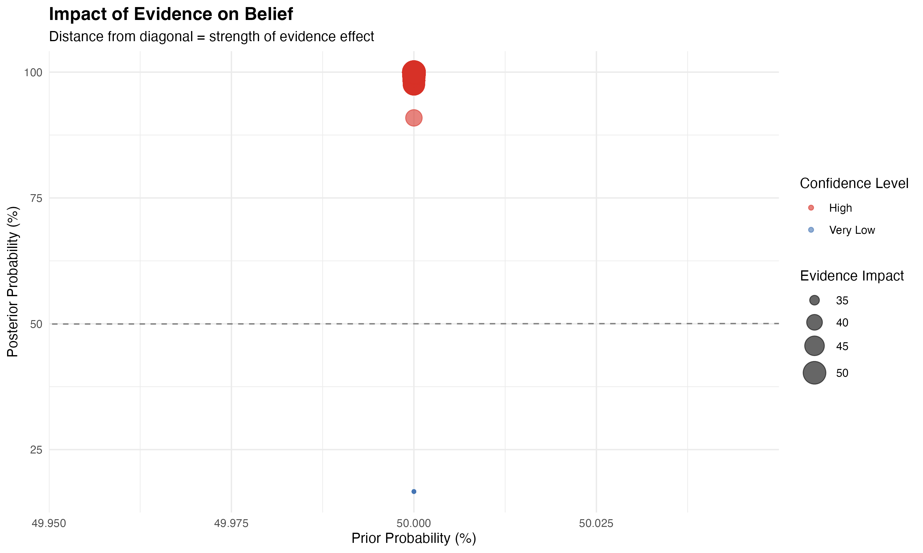
Figure 6: Bayesian prediction

Slide 24
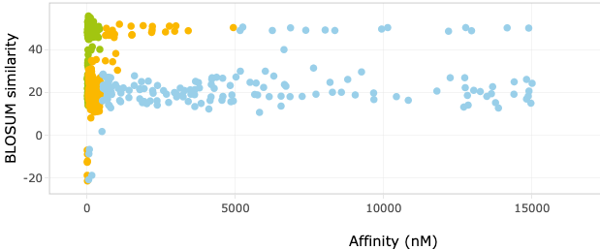
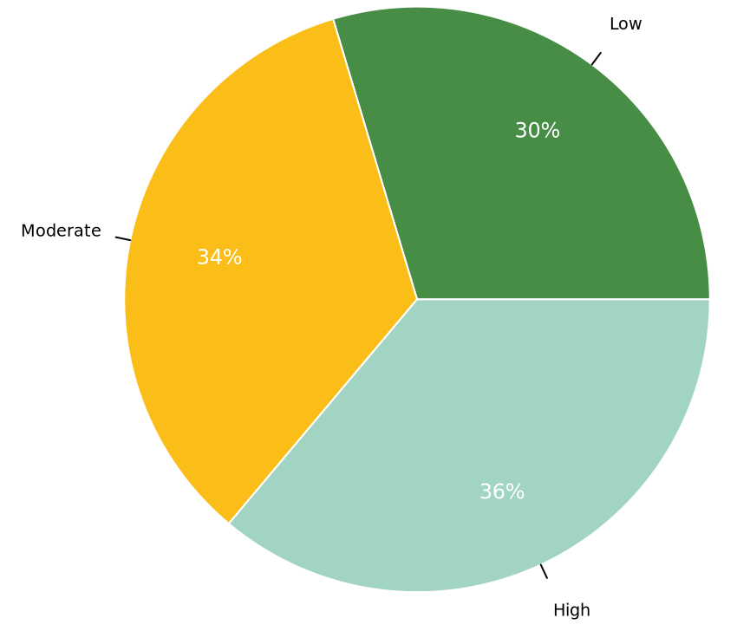
Figure 7: bi-features score
Kmean clustering
Affinity
Similarity
High affinity
0 - 50_{nM}
Med affinity
50 - 500_{nM}
KVAELVHFL |0| 44
KMAELVHFL |1| 41
KMAECAHFH |4| 25
KMAEEVGKL |4| 15
…
Low affinity
500 - 5k_{nM}
Random affinity
Supervised machine learning
Maintaining biological meaning
Indirectly reflects biochemical properties

Slide 25
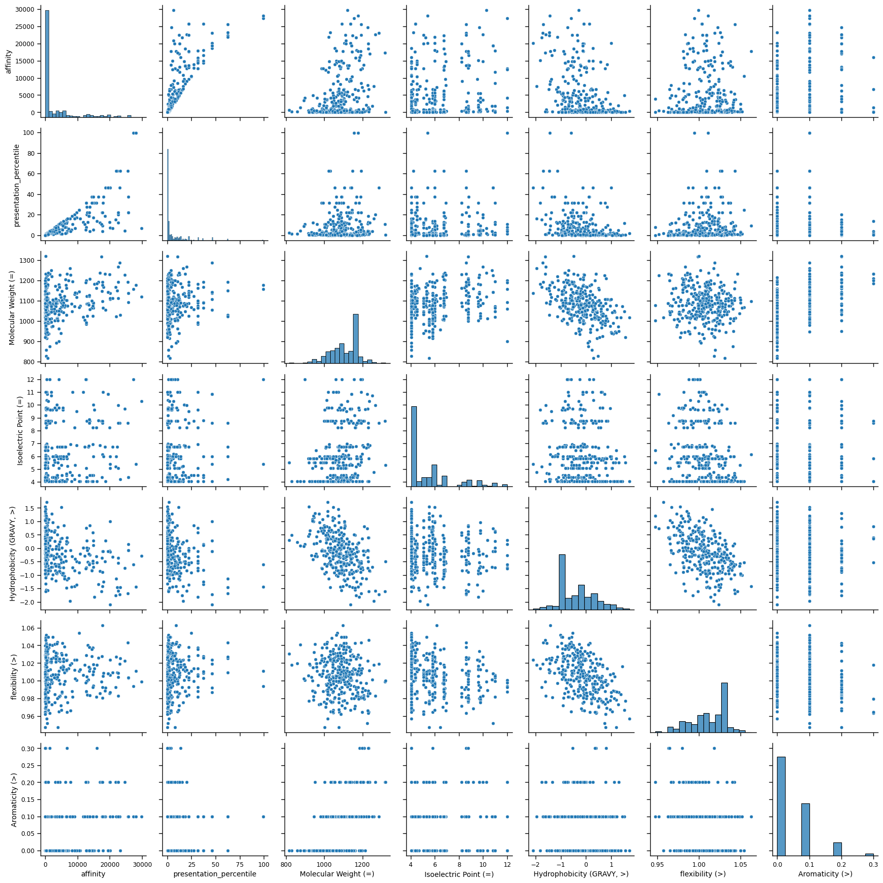
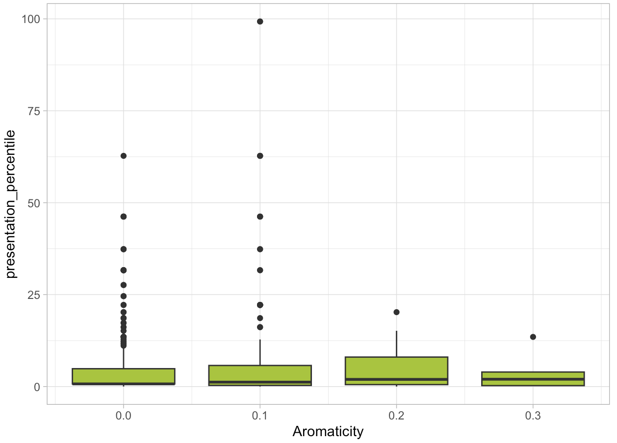
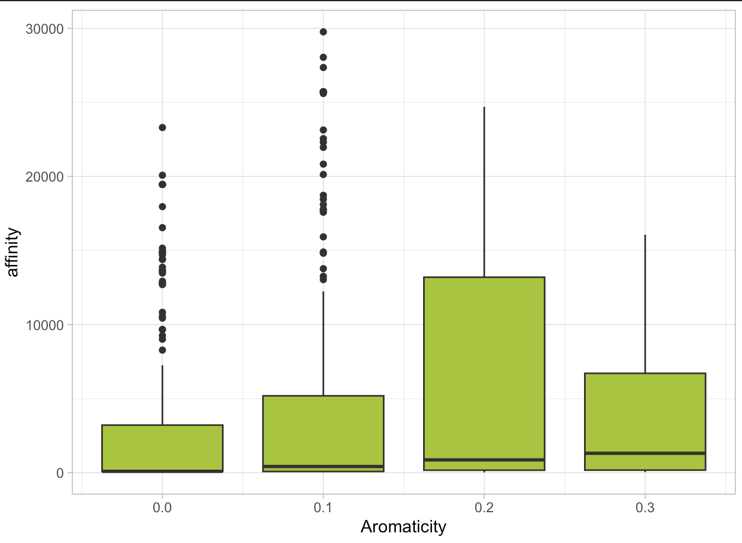
Biophysical properties correlation
Features | Expectation
Aromaticity - affinity | Negative correlation
Gravy* - affinity | Depends on the allele
MW* - presentation | Positive
Flexibility* – immune resp | Yet to come!
Isoelectric* - affinity
* Compared to the target

Slide 26
Biophysical properties – clustering
PCA 2 - Clusters 3: Silhouette Score = 0.510
✔ Affects solubility, protein interactions, & stability in biological fluids
✔ pI affects peptide charge, which in turn influences HLA binding affinity. ✔ Charge complementarity between peptide and HLA binding pockets plays a role in binding stability. ✔ TCR recognition may be affected by solvent-exposed charged residues, impacting immune activation.

Slide 27




Figure 8: multi-features score
Multiple feature
Dimension reduction
Unsupervised clustering
$$x_{norm}(m×n)$$
$$z (m×k)$$
Affinity to HLA
BLOSUM similarity
…
PCA / t-SNE / UMAP
…
High
Stability score
Z $=DR(X_{norm})$
Medium
Immunogenicity
Normalize
Cluster
Rank
Low
.. (n features)
Final score:
S = f(cluster, distance)
Reduced feature space
$$x∈ℝ^{m×n}$$
High-dimensional (many features)
Low-dimensional (k < n)
…
Methods:
PCA: linear projection
t-SNE: non-linear embedding
UMAP: Topology preserving
Methods:
K-means
Hierarchical
DBSCAN
…
…

Slide 28

Figure 9: xscan motif binding

Slide 29
Figure1: SNPs integration
Off-targets
WT only
Off-targets genomic location
Extract SNPs
QC: PASS
AF > 0.1
Population ID
Mutate off-targets
Edit distance < threshold
Off-targets
WT + MUT
Annotate SNPs
SNPs Exom file
SNPs annotation
Peptide | Found SNPs | Mutated sequence | Notion
KVAELVHFL | - | - | WT
 | SNP₁:A₂ | KAAELVHFL | MUT
 | SNP₂:A₈ | KVAELVHAL | MUT
 | SNP₁:A₁ | AVAELVHFL | MUT

Slide 30
Figure 4

